Slide 1

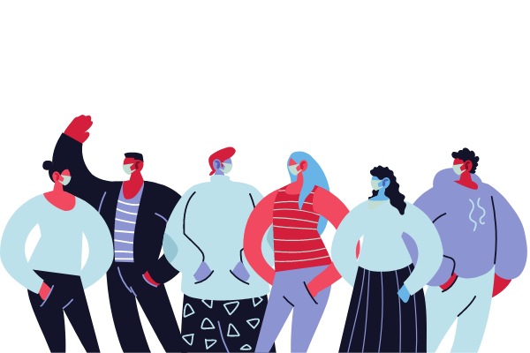
A mobile clinic for the COVID-19 vaccine
will visit this facility on
____day, Month, ___
at ___ am/pm
ADD INSTRUCTIONS FOR HOW TO REGISTER/SIGN-UP
The Moderna vaccine is for people age 18 years and older, should receive 2 doses at least 28 days apart.
The Pfizer vaccine is for people 16 years or older, should receive 2 doses at least 21 days apart.

