Slide 1

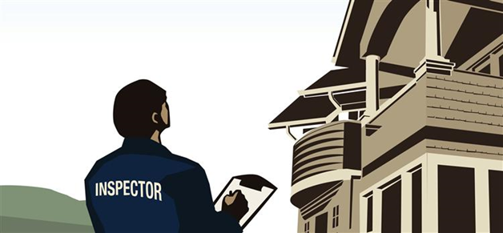

Inspection Training

Slide 2

AGENDA
Introduction
Importance of Inspections
Housing Quality Standards
HUD Conditions for Landlords
HUD Inspection Form Walk-Thru
Lead-Based Paint Form
Facility Habitability Checklist
Q & A

Slide 3
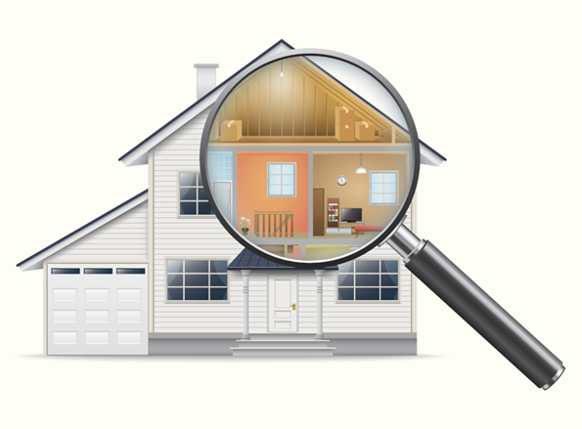
The Importance of Inspections
Inspections are a vital aspect of any housing program and are a key element in not only ensuring that our clients are being taken care of, but also in maintaining good standing relationships with our landlord partners. They confirm that our clients are living in a safe and completely functional unit or home. Inspections also play an important role in giving landlords and their maintenance staff an advance warning on possible issues they may not have been aware of which could save them money in the long run.
Notes:
Every month CSB averages between 45 – 60 in home inspections for our partner agencies around Columbus. Each inspection has a report that is usually compiled within 24 hours of the visit, and the results are then sent to the partner agency working directly with the client and the landlord of the property.
3

Slide 4
The Housing Quality Standards (HQS) Inspection
Housing quality standards (HQS) inspections ensure that your unit is safe and sanitary. An initial HQS inspection is required before assistance can be provided. After that, the unit will be subject to annual inspections to continue in the program. Complaint and quality control inspections may be performed between annual inspections.
If a unit fails the initial inspection, all failed items must be corrected prior to subsidy being paid on the unit. If it fails an annual inspection, failed items must be corrected for the subsidy to continue. The owner or property manager is required to repair items within 30 days or less as specified in the inspection report. However, if the failed item is considered life-threatening, federal law requires the repair to be made within 24 hours.
Additional time may be granted in cases where extensive repairs are needed. If items that failed inspection are not repaired in the required time, CSB may begin withholding housing assistance payments.
Notes:
4

Slide 5
HQS Condition Checklist for Landlords
Each unit rented under the CSB Rental Assistance and other system programs must pass a Housing Quality Standards (HQS) inspection. Units sometimes fail housing inspections because landlords and tenants are not familiar with HQS requirements and/or have not assessed the condition of the unit prior to the scheduled inspection. For these reasons, CSB encourages landlords to conduct pre-inspections prior to the scheduled inspection. If the most commonly failed items are corrected before the inspection, the unit will have a much better chance of passing the inspection the first time. All utilities must be connected before an inspection can be conducted. Listed in the next few slides are the expectations for owners to prepare their unit for an HQS inspection. The items on this checklist must be working or completed prior to the HQS inspection.

Slide 6
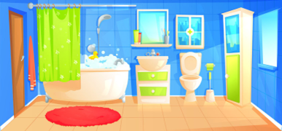
The Bathroom
• The bathroom must be located in a separate room and have an operational toilet.
• The unit must have a fixed basin with a sink trap and hot and cold running water.
• The unit must have a shower or bathtub with hot and cold running water.
• The toilet facilities must utilize an approvable public or private disposal system, including a locally approvable septic system.

Slide 7
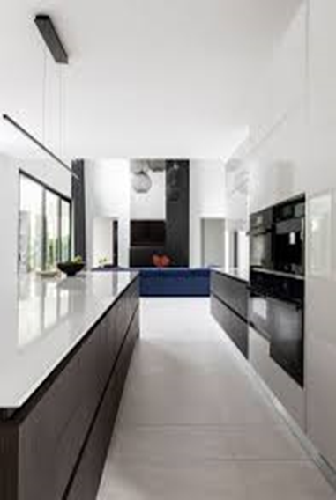
The Kitchen
The unit must have a cooking stove or range and refrigerator of appropriate size for the unit (i.e., family) all in proper operating condition. Stoves, ovens, and ranges must be in working condition with all control knobs and handles. Pilots must light when burners and oven are turned on. The refrigerator gasket must be intact, fit snugly, and have no cracks. The kickplate must be secured properly.
The unit must have a kitchen sink in proper operating condition with a sink trap and hot and cold running water, which drains into an approvable public or private wastewater system.
The unit must provide space for the storage, preparation, and serving of food.
There must be facilities and services for the sanitary disposal of food waste and refuse, including temporary storage facilities where necessary (i.e., garbage containers).

Slide 8

Space & Security
The unit must have a minimum of a living room, kitchen area, and bathroom.
The unit must contain at least one sleeping or living/sleeping room for each two persons.
The unit’s windows, which are accessible from the outside (less than 6 feet off the ground), such as basement, first-floor, and fire escape windows, must be lockable (e.g., window units with sash pins or sash locks, and combination windows with latches). Security bars are allowed. However, if they are installed on bedroom windows and/or exit doors they must be designed to allow emergency egress.
Vertically opening windows must stay up and open without the use of props.
Windows designed to open should be in working condition.
Windowpanes must not be broken or cracked.
The unit’s exterior doors (i.e., those that allow access to or from the unit) must lock properly and be compliant with current local Property Code requirements regarding security devices for residential tenancies. Striker plate must align with lock and all hardware must be securely attached. If gaps allow for air infiltration, weather-stripping should be applied.

Slide 9
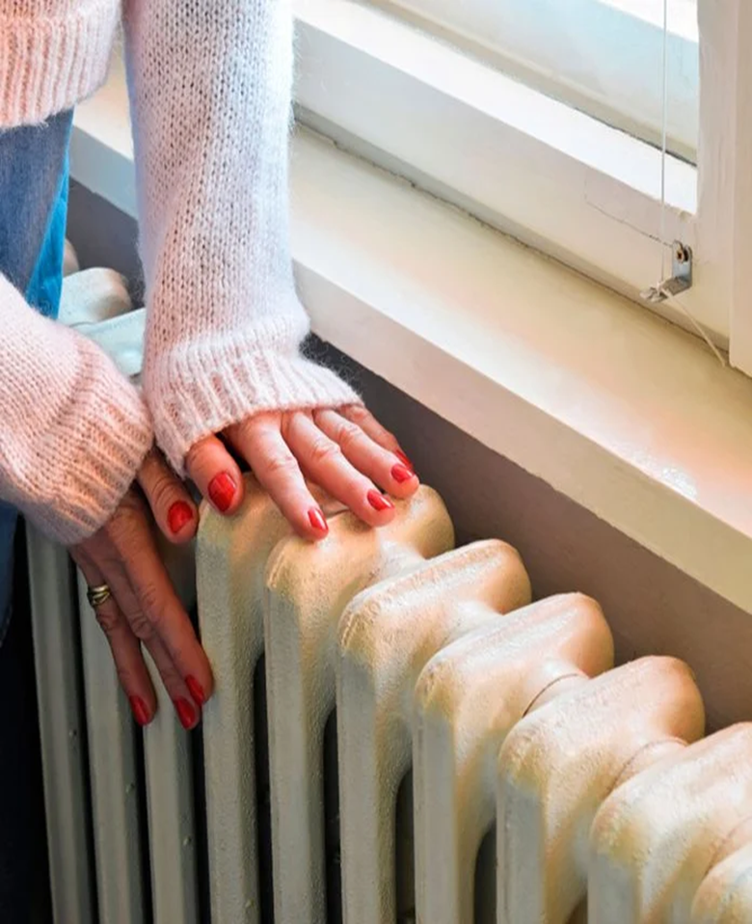
Thermal Environment (Heating & Cooling System)
The unit must contain a safe heating system (and safe cooling system, where present), which is in proper operating condition and can provide adequate heat (and cooling, if applicable), either directly or indirectly, to each room used for living in order to assure a healthy living environment appropriate to the climate.
Hot water heaters must have a pressure relief valve and discharge line that extends to within 6 inches of the floor or to the outside. Discharge tubing must be galvanized steel, copper or CPVC piping, not PVC. There should be no exposed wires. Flammable materials should not be stored near the hot water heater. Gas water heaters must be properly vented.
The unit must not contain any unvented room heaters, which burn gas, oil, or kerosene. A working radiator would be acceptable.
Notes:
The lack of affordable housing means people are stuck in shelter longer. This is because there are only 32 affordable homes available for every 100 extremely low-income families in Franklin County that need them.

Slide 10
Illumination & Electricity
There must be at least one window in the living room and in each sleeping room.
The kitchen area and the bathroom must have a permanent ceiling or wall type light fixture in working condition.
The kitchen area must also have at least one electrical outlet in operating condition.
The living room and each bedroom must have at least two electrical outlets in operating condition. Permanently installed overhead or wall-mounted light fixtures may count as one of the required electrical outlets.
All other rooms used for living require a means of natural or artificial illumination such as a light fixture, a wall outlet to serve a lamp, a window in the room, or adequate light from an adjacent room.
Each electrical outlet must be permanently installed in the baseboard, wall, or floor. No extension cords may be used for outlets.
Table or floor lamps, ceiling lamps plugged into a socket, or an extension cord plugged into another plug cannot be counted as an outlet for HQS purposes.
Electrical hazards of any kind, either inside or outside the unit would receive a failure rating.
Notes:
Longer shelter stays and the increasing cost of rent means the cost to re-house a homeless family has doubled in the past 5 years. Costs add up between families staying longer in shelter and the increasing costs of rent and security deposits.

Slide 11
Structure & Materials
Interior ceilings, walls, and floors must not have any serious defects such as severe bulging or leaning, large holes, loose surface materials, severe buckling, missing parts, or other serious damage.
The floors must also not have any major movement under walking stress, or tripping hazards presented by the permanent floor coverings.
The roof must be structurally sound and weather tight.
The exterior wall structure and surfaces must not have any serious defects such as serious leaning, buckling, sagging, large holes, unfastened and falling components, or defects that would result in air infiltration or vermin infestation.
The condition and equipment of interior and exterior stairways, halls, porches, walkways, etc. must not present a danger of tripping and falling. Examples of dangerous conditions include, but are not limited to, broken or missing steps and loose boards.
Stairways with four or more steps must have a handrail that is securely supported and runs the length of the stairway.
Railings are required for decks, porches or steps that are more than 30 inches from the ground.
Elevators must be working, safe, and compliant with locally enforced codes.
Manufactured homes must be securely anchored by tie down devices, which distribute and transfer the loads imposed by the unit to appropriate ground anchors so as to resist wind overturning and sliding.
Notes:
The outcomes achieved by our homelessness prevention and re-housing system are significantly impacted by the deepening affordable housing crisis. Between more people needing services than ever before and the affordable housing crisis, our partner agencies are up against significant barriers to success. Despite this, they continue to get people off the streets, keep them safe in shelter, and rehouse them.
While we work as part of the community effort advocating for the development of deeply affordable housing, we continue to develop and implement creative and innovative strategies to mitigate the realities of a very difficult housing environment. Just a few examples:
Launched the Homelessness Prevention Network to stabilize families before they becomes homeless and reduce demand on emergency shelters.
Hired a Community Housing Manager who actively engages and recruits local landlords willing to prioritize open units for our vulnerable individuals in emergency shelter. We have 659 active landlords in our network and added 48 new landlords in the past 12 months due to these efforts.
Hired a Housing Inspector who completes inspections within an average of 4 days to speed exits from shelter. Doing these inspections ourselves significantly cuts time in shelter.
Hired a Client Housing Manager who works with our partners, local agencies, and government entities to obtain client documentation for housing and speed exits from shelter.
Created a recruitment fund that pays landlords incentives of $500-$750 for any new unit provided to our re-housing system.
Created a risk mitigation fund to provide landlords an additional safety net, beyond a normal security deposit, when housing renters who would otherwise be considered too risky.
Our community is changing dramatically. In partnership with the City of Columbus, Franklin County Board of Commissioners, and the Columbus Partnership, CSB is commissioning a comprehensive study called A Place to Call Home for Everyone: A Comprehensive Study on Homelessness and Housing in Columbus and Franklin County to evaluate our community’s current response to homelessness and develop strategies for the future state.

Slide 12

Interior Air Quality
The unit must be free from dangerous levels of air pollution from carbon monoxide, sewer gas, fuel gas, dust, and other harmful pollutants.
The unit must have adequate air circulation.
Bathrooms must have a window that opens properly or a permanently installed exhaust fan.
Any room used for sleeping must have at least one window that opens properly, if the window was so designed.

Slide 13
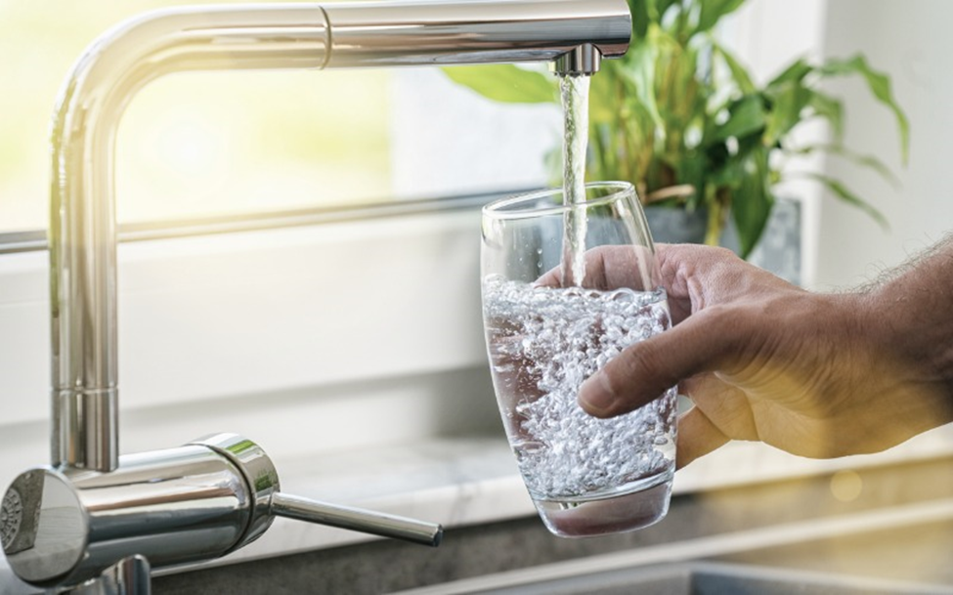
Water Supply
An approvable public or private water supply must serve the unit, which is sanitary and free from contamination.

Slide 14
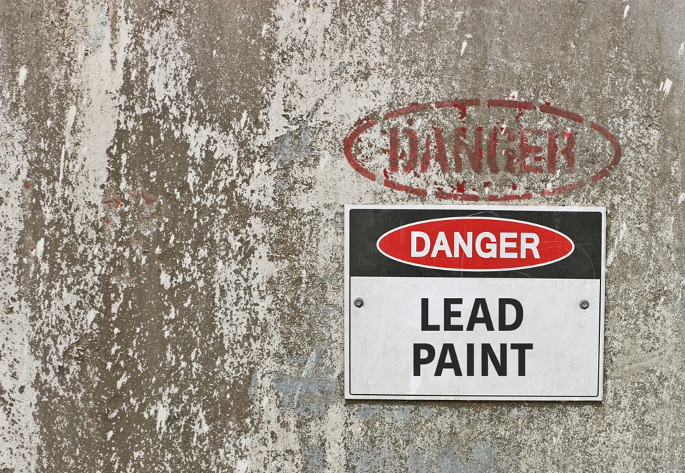
Lead-Based Paint
• A dwelling unit constructed before 1978 that is occupied by a family that includes a child under the age of six years must include a visual inspection for defective paint surfaces. Defective paint surface is defined as a surface on which the paint is cracking, scaling, chipping, peeling or loose. If defective paint surfaces are found, such surfaces must be treated in accordance with state and EPA requirements.

Slide 15
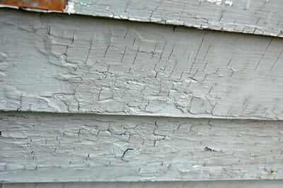
Cracking Lead-Based Paint (Example)

Slide 16
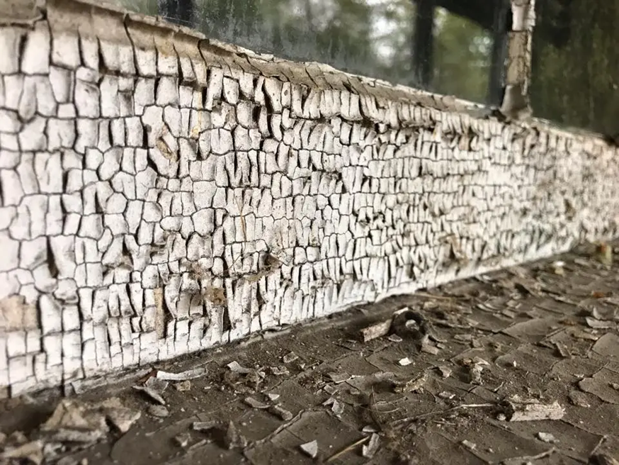
Scaling Lead-Based Paint (Example)

Slide 17
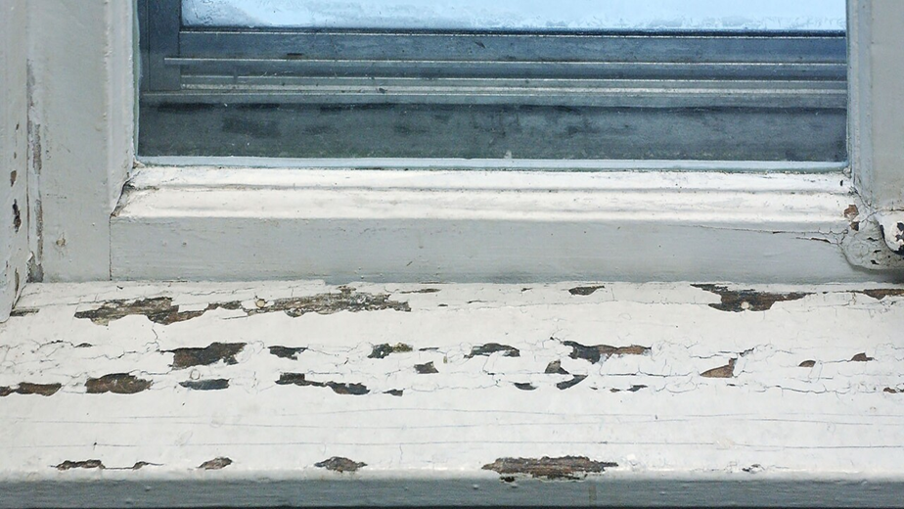
Chipping Lead-Based Paint (Example)

Slide 18
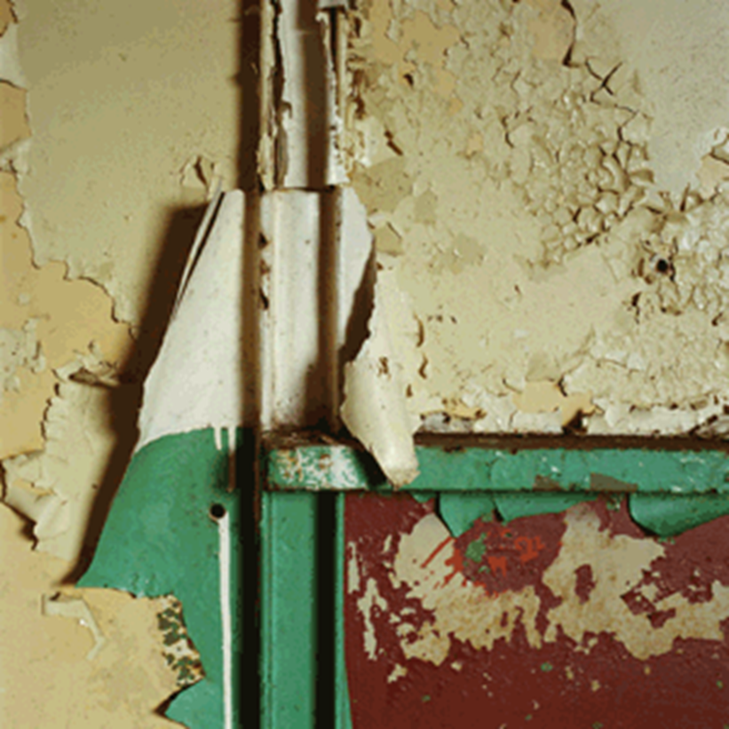
Peeling Lead-Based Paint (Example)

Slide 19
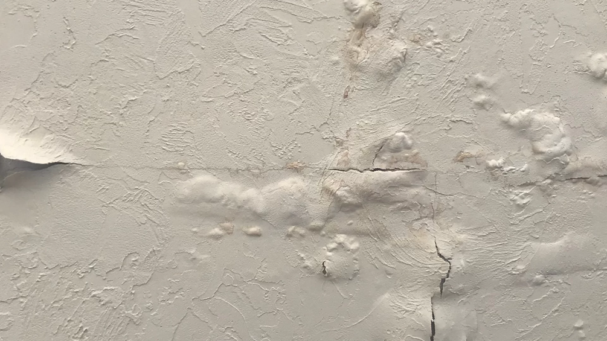
Loose Lead-Based Paint (Example)

Slide 20
Access
The unit must have direct access for the tenant to enter and exit, without the unauthorized use of other private properties.
The building must provide an alternate means of exit in case of fire (such as fire stairs or exit through windows, with the use of a ladder if windows are above the second floor).
Entry/exits must not be “blocked” by debris, stored items, non-working locks, or doors that have been nailed shut or otherwise obstructed.

Slide 21
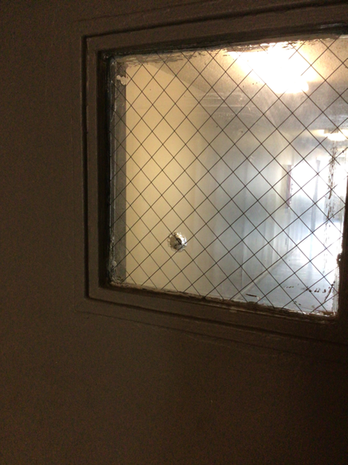
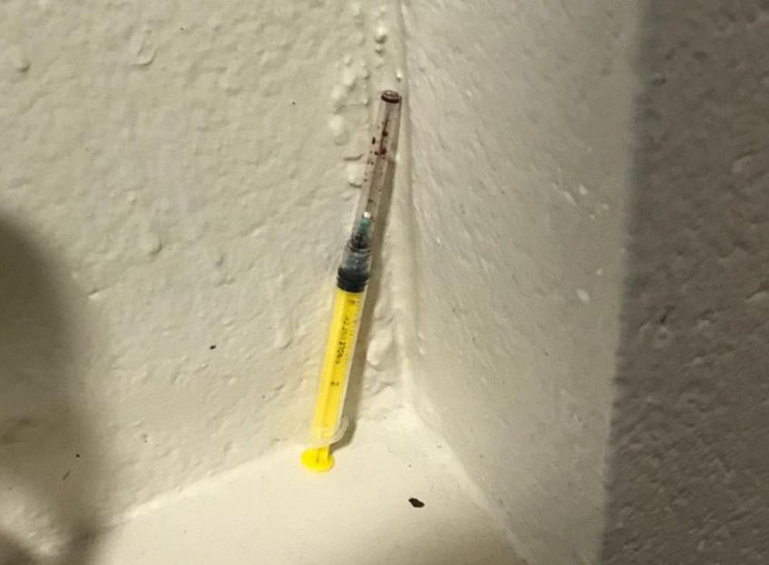
Site & Neighborhood
The site and neighborhood must be reasonably free of serious conditions, which would endanger the health and safety of residents.

Slide 22

Infestation
• The unit and its equipment must be free of serious vermin, insect and rodent infestation.

Slide 23
Smoke Detectors
• The unit must have at least one battery operated or hardwired smoke detector that is in proper operating condition on each level of the unit, including basements but excluding crawl spaces and unfinished attics. Detectors must be installed in accordance with and meet the requirements of the National Fire Protection Association Standard NFPA 74 or its successors currently NFPA 720. If any hearing-impaired person occupies the unit, smoke detectors must have an alarm system designed for hearing-impaired persons as specified by NFPA 74 or its successors. In new construction, there must be a smoke detector in each room used for sleeping, and those must be arranged so that the operation of any detector will cause all other detectors to alarm.

Slide 24
Utilities
• All landlord provided appliances must be in place at the time of the inspection.
• All utilities (water, electricity, and gas where applicable) should be on at the time of the inspection.
• All gas appliances with manual pilot light must have pilots lit at the time of the inspection.

Slide 25
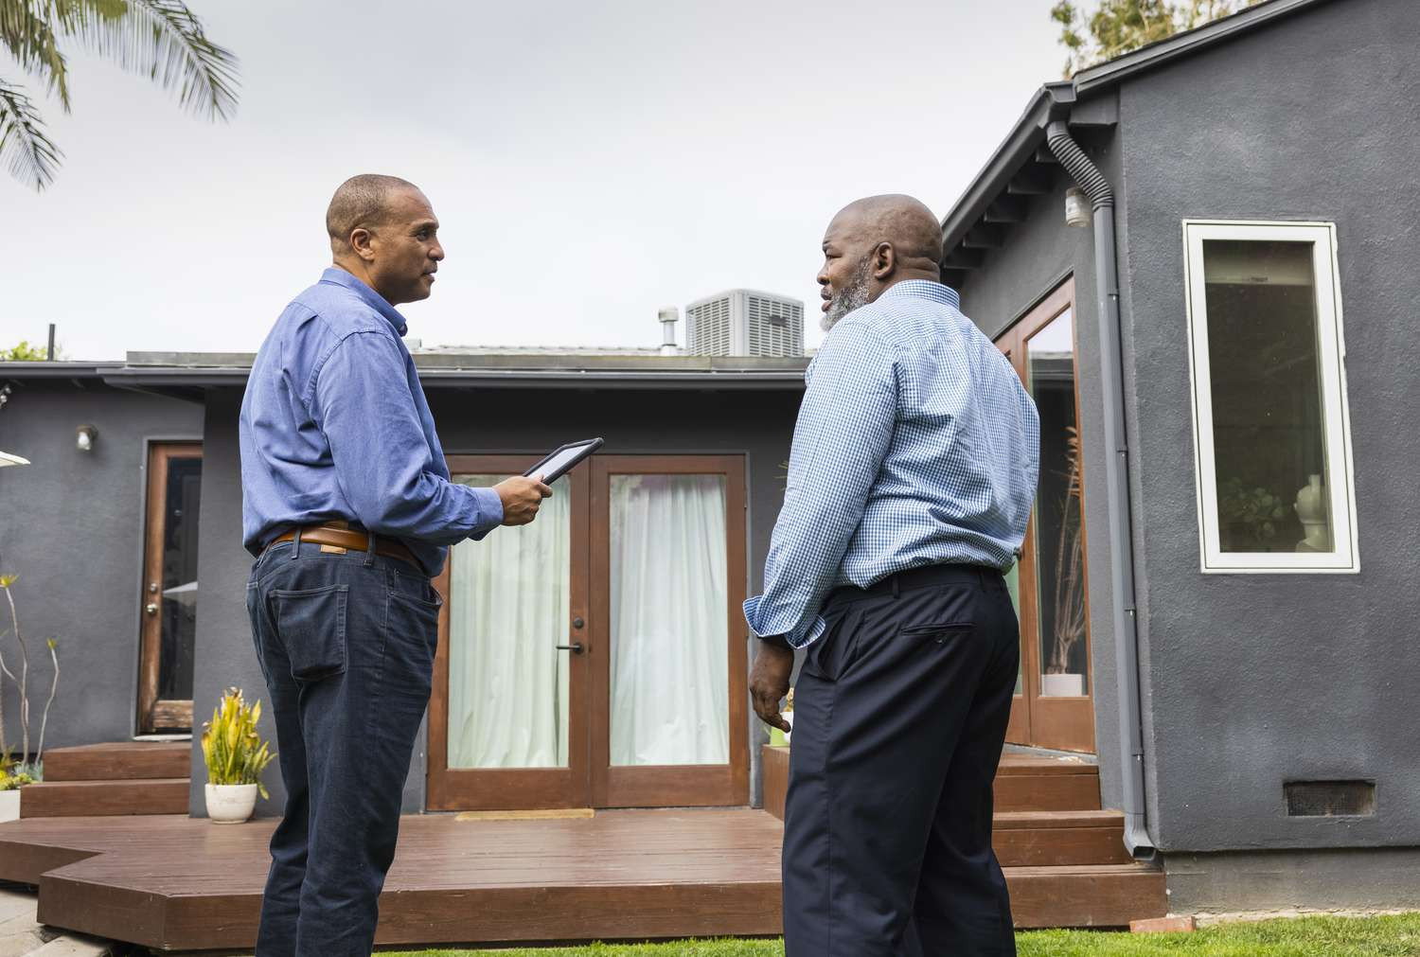
Client & Case Worker Walk Through
Clients and their case worker should coordinate a time in which they both can meet at the prospective unit or home and conduct a walk through themselves prior to inspection as well. This helps to ensure that the client is satisfied with the size and condition of the unit. It also ensures that the client feels comfortable in their new neighborhood and the surrounding area.

Slide 26
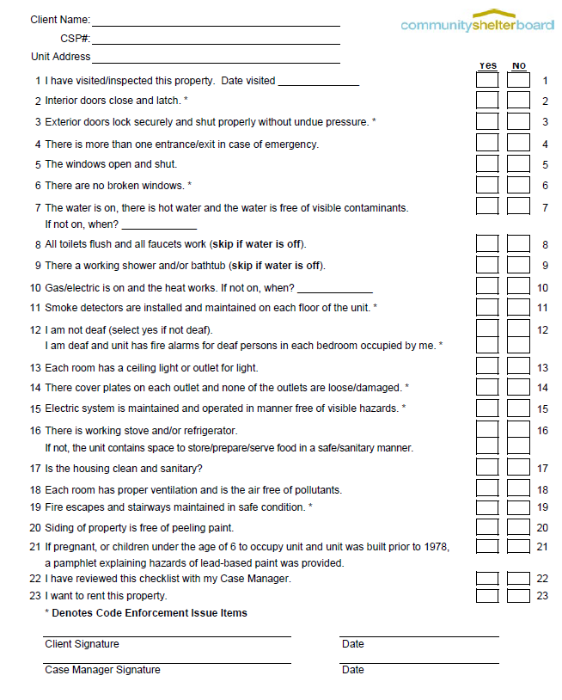
Client & Case Worker Unit Checklist

Slide 27
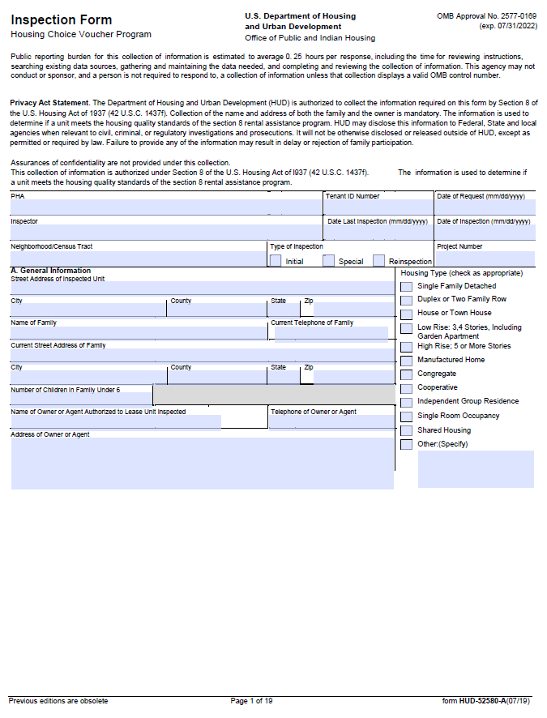

HUD HQS Inspection Form

Slide 28
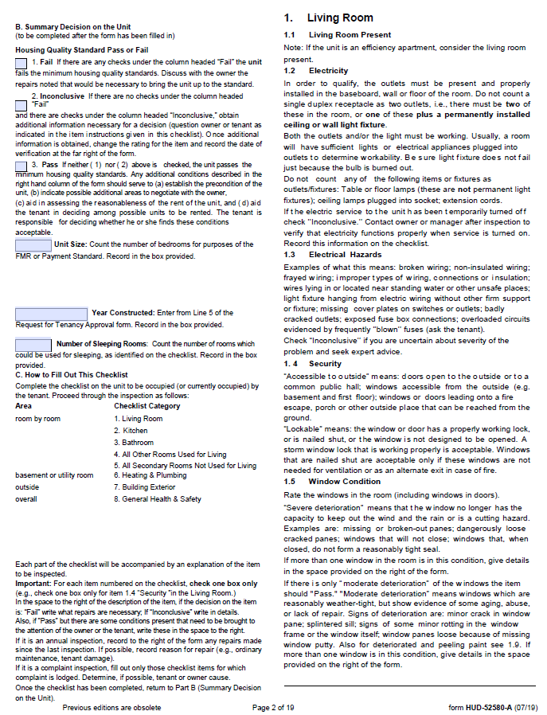

HUD HQS Inspection Form (Living Room)

Slide 29
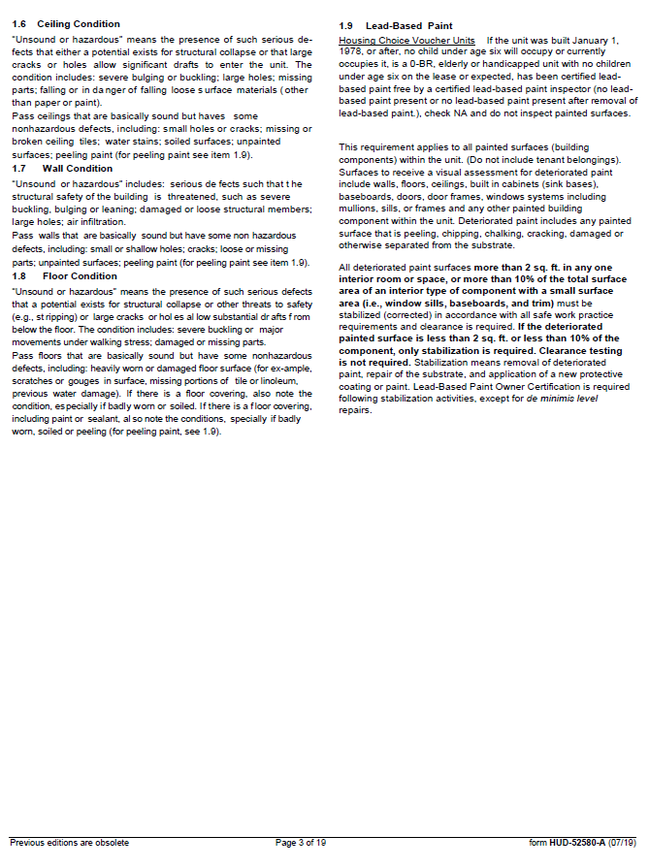
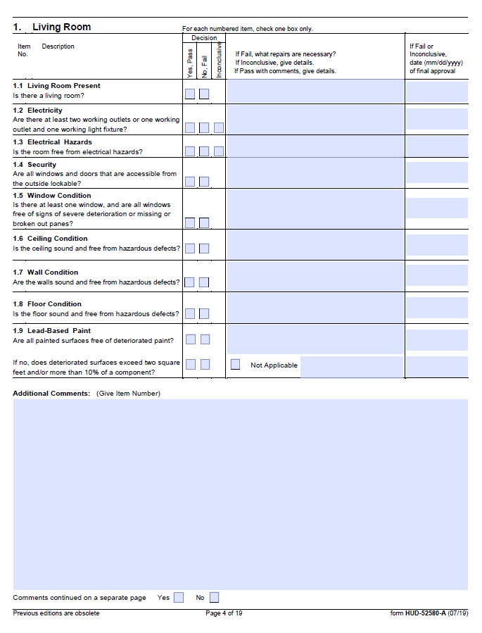
HUD HQS Inspection Form (Living Room Cont.)

Slide 30
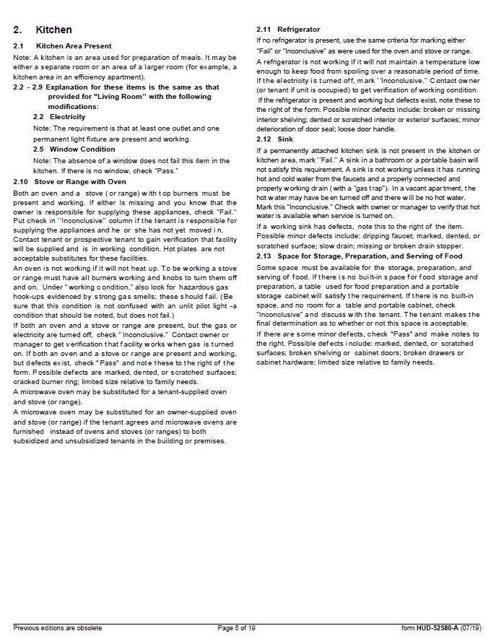
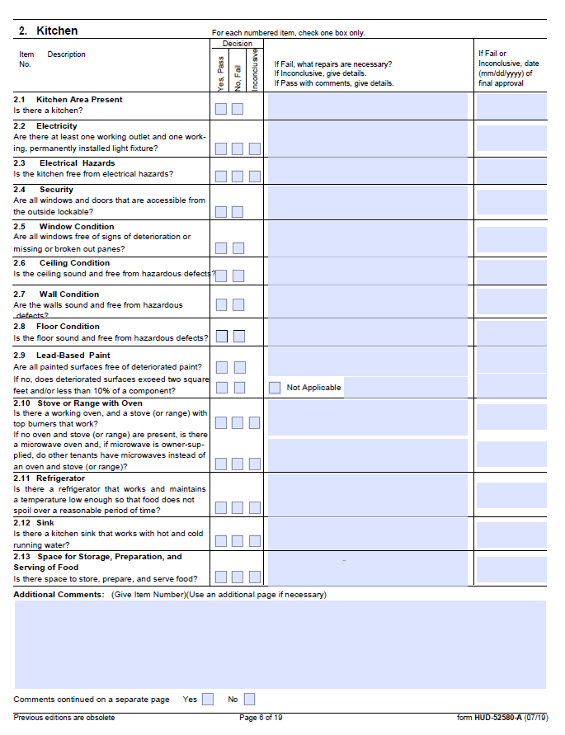
HUD HQS Inspection Form (Kitchen)

Slide 31
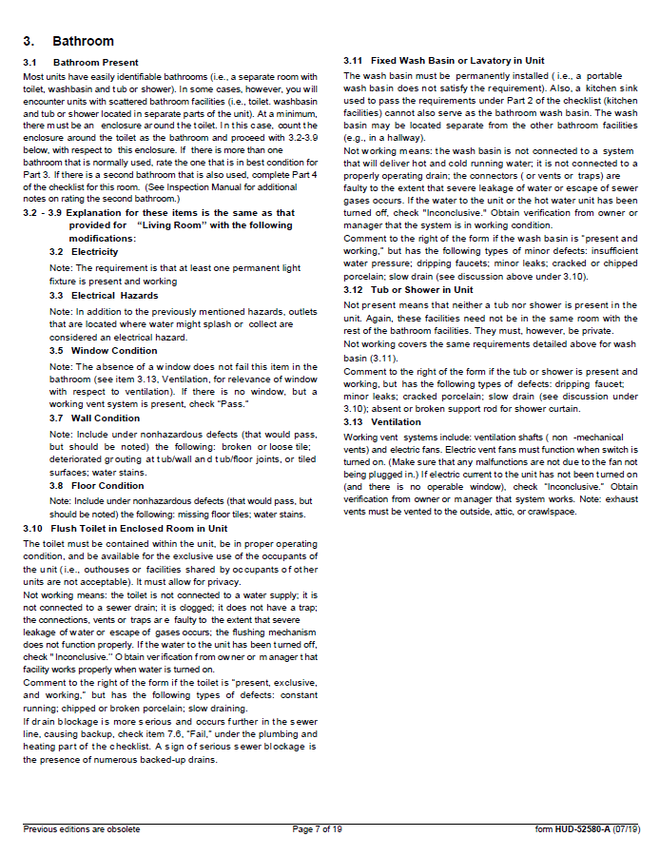
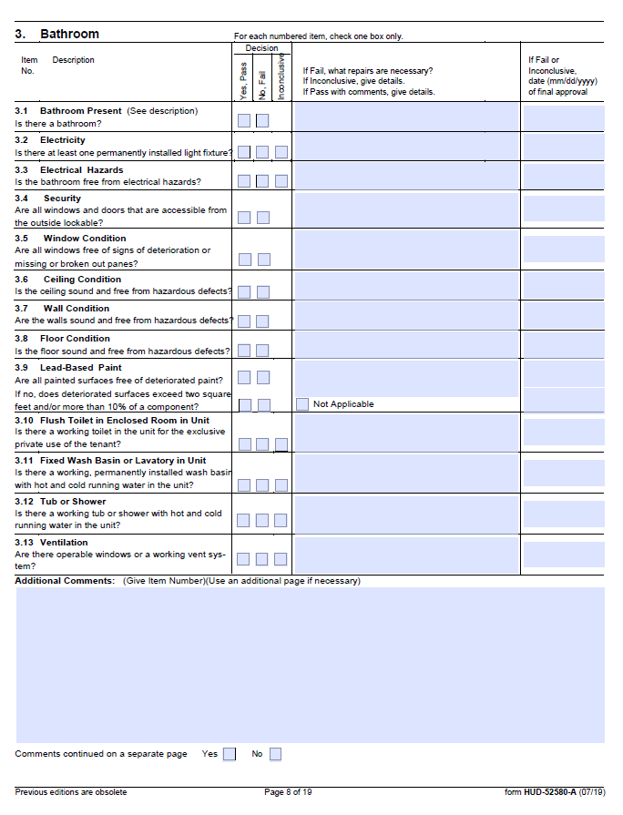
HUD HQS Inspection Form (Bathroom)

Slide 32
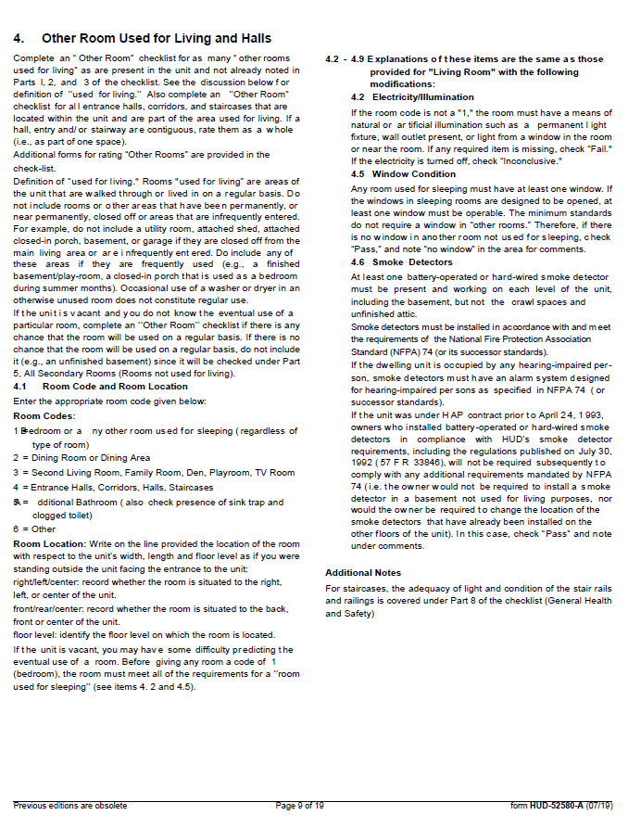
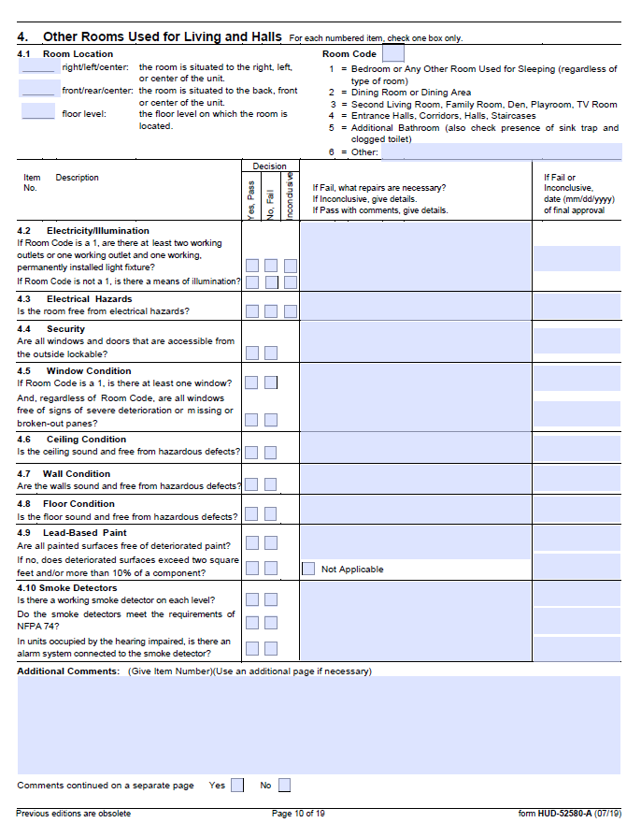
HUD HQS Inspection Form (Other Rooms with Codes)

Slide 33
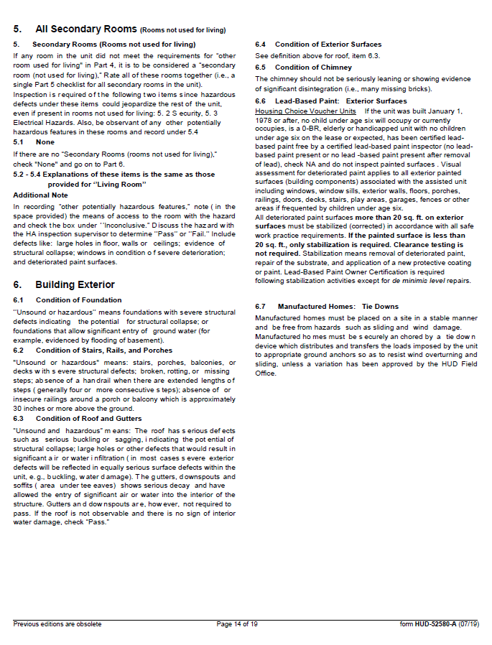
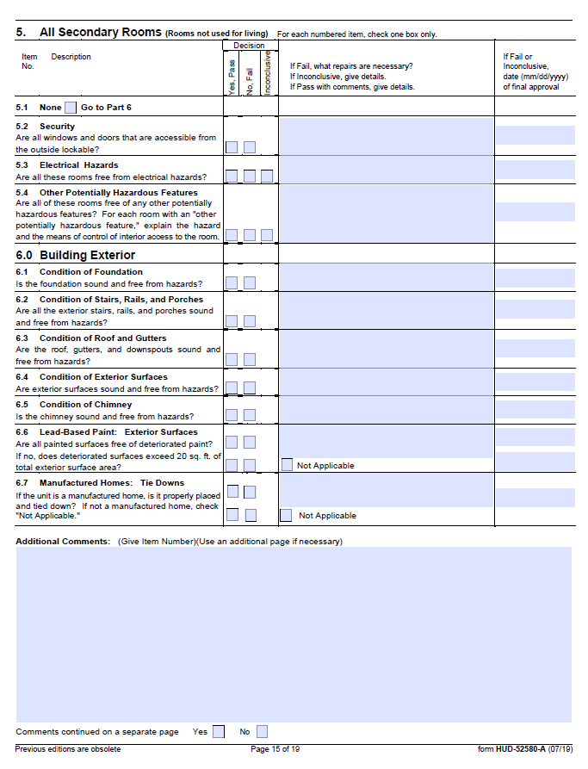
HUD HQS Inspection Form (All Secondary Rooms)

Slide 34
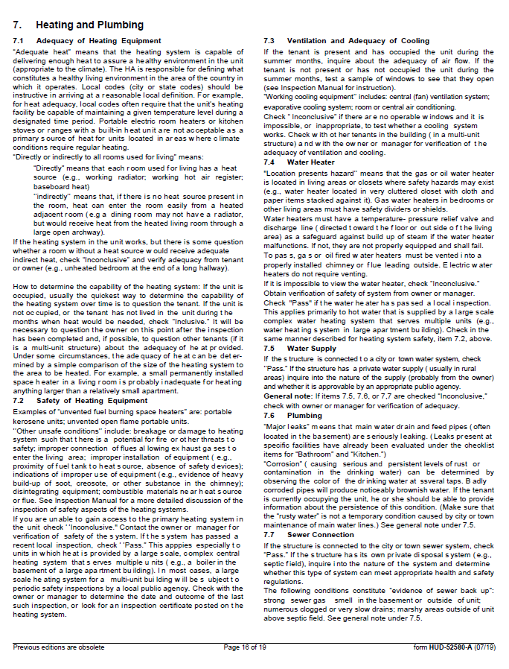
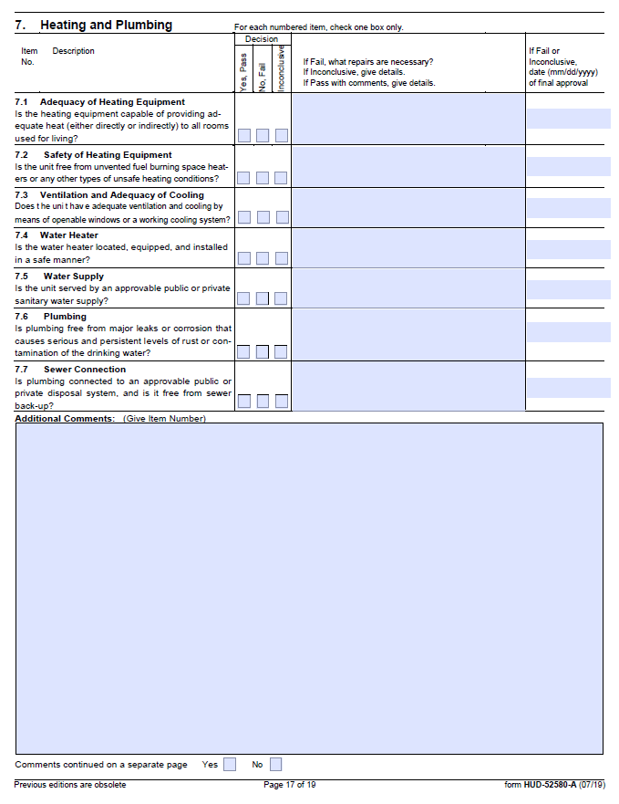
Heating & Plumbing

Slide 35
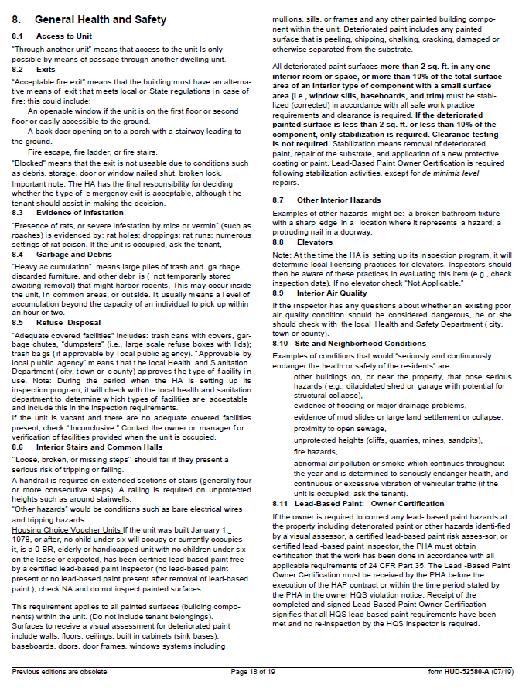
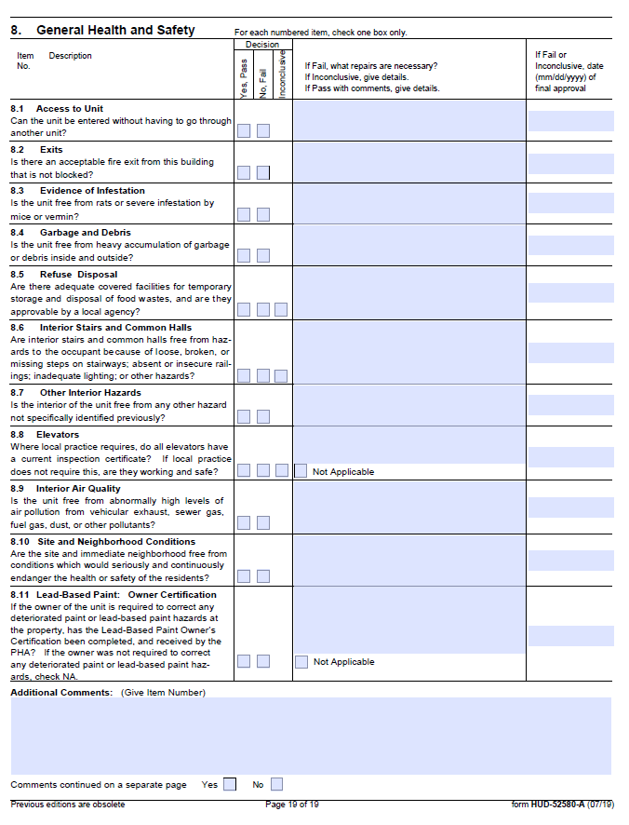
General Health & Safety

Slide 36
Lead-Based Paint Visual Assessment Course
Anyone who conducts inspections whether it be regularly or sporadically should first take the HUD Visual Assessment Course located at https://apps.hud.gov/offices/lead/training/visualassessment/h00101.htm.
This short course will go over the specific things you need to look for when assessing units that may contain lead-based paint and it only takes about 15 minutes to complete. Upon completion you will receive a certificate from HUD which the participant should keep on file.

Slide 37
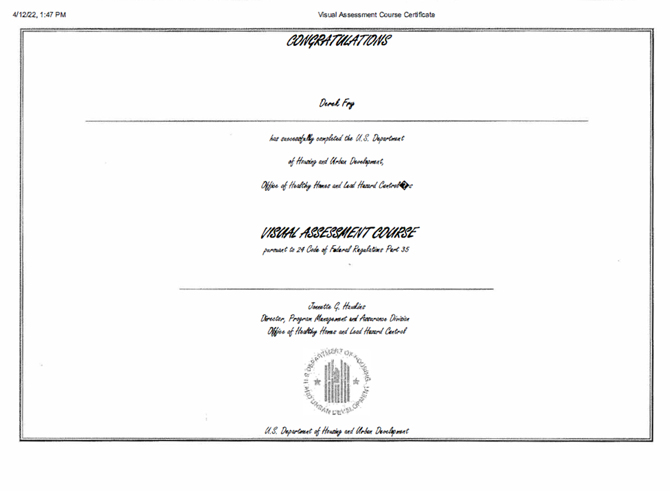
Lead-Based Paint Visual Assessment Course

Slide 38
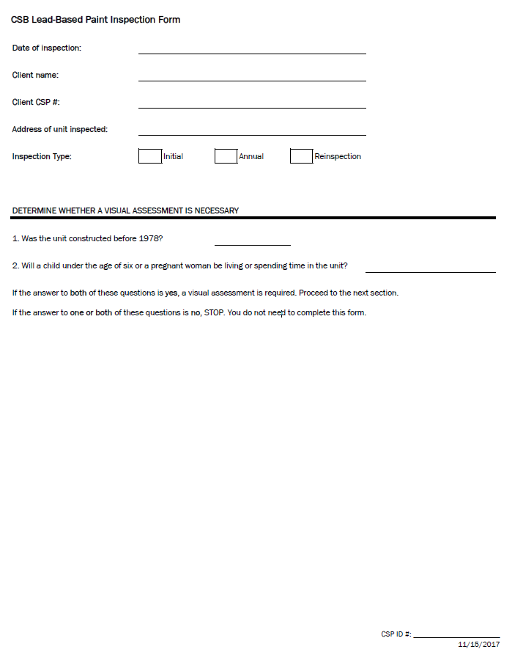
Lead-Based Paint Form (Page 1 of 3)

Slide 39
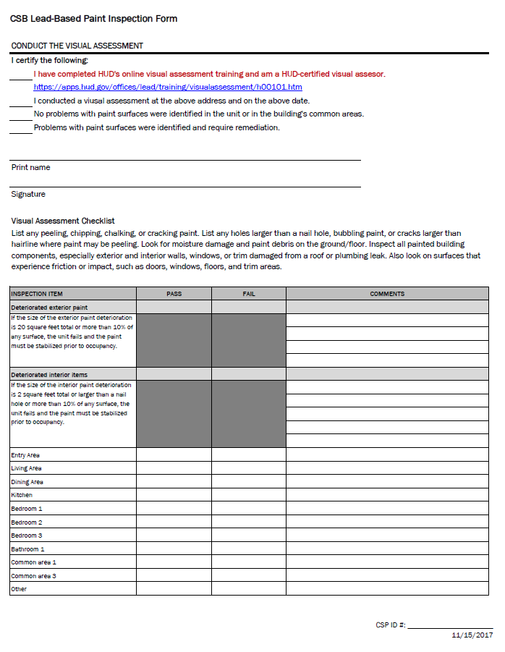
Lead-Based Paint Form (Page 2 of 3)

Slide 40
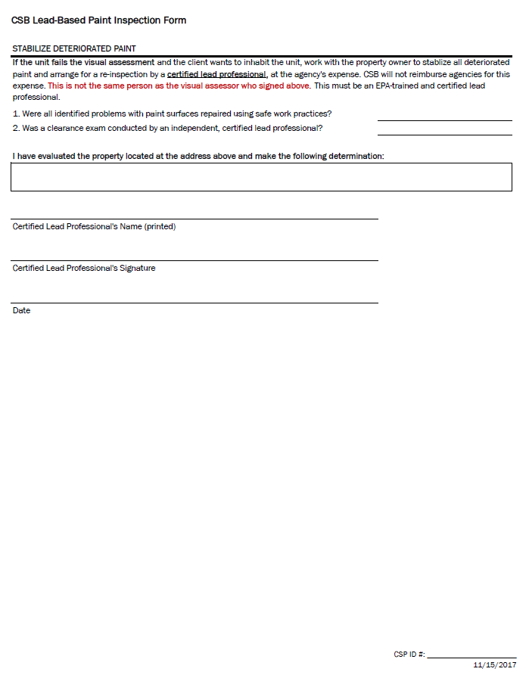
Lead-Based Paint Form (Page 3 of 3)

Slide 41
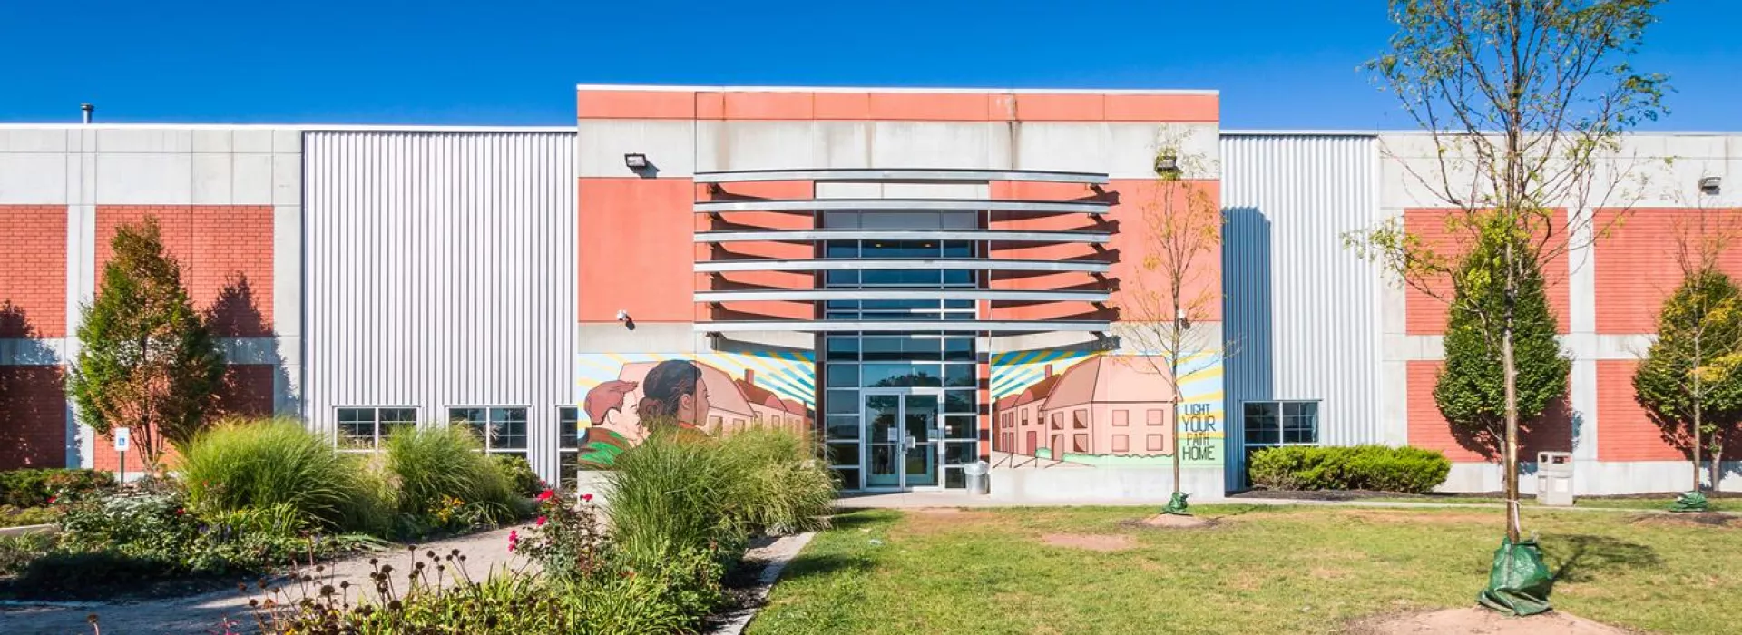
Facility Habitability Inspections
Organizations which house a higher volume of clients within a facility setting must also undergo inspections to obtain annual government funding. Inspections must be conducted upon initial occupancy and then on an annual basis for the term of assistance. These inspections play a pivotal role in ensuring that organizations are cognizant of major repairs/preventative maintenance items so that they can properly allocate their budget if needed.

Slide 42
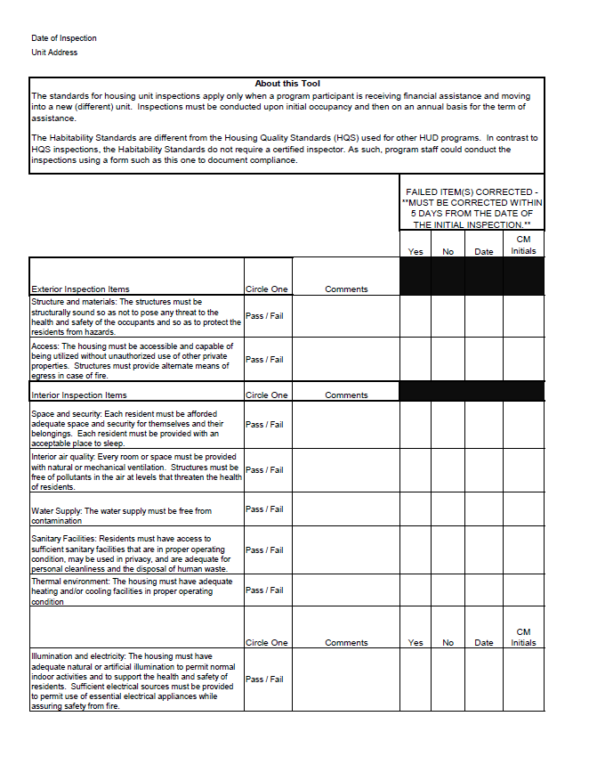
Facility Habitability Checklist (Page 1 of 3)

Slide 43
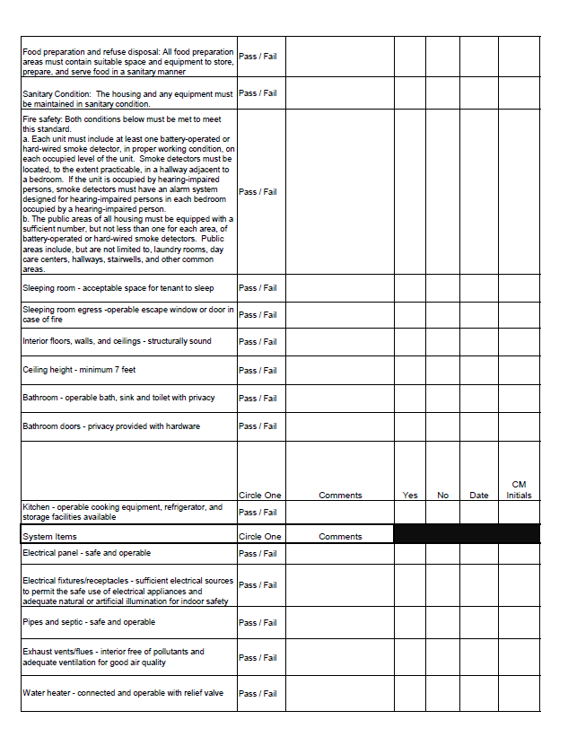
Facility Habitability Checklist (Page 2 of 3)

Slide 44
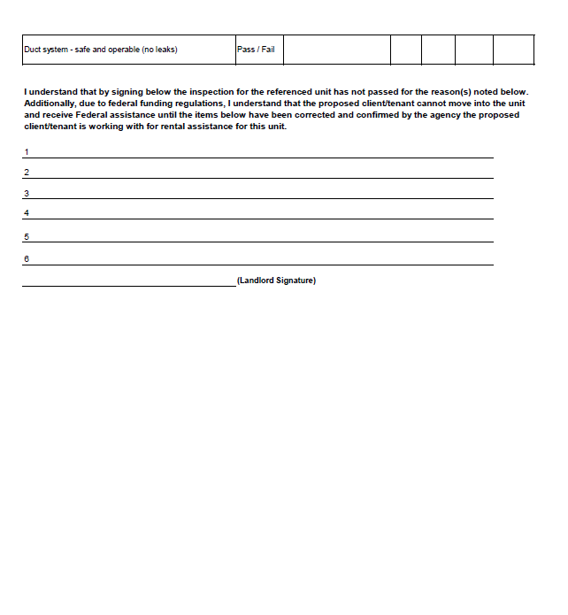
Facility Habitability Checklist (Page 3 of 3)

Slide 45
Questions?
Derek Fry, Housing Inspector
dfry@csb.org

