Slide 1
CODE ENFORCEMENT
City of Columbus

Slide 2
Code Enforcement
Property Maintenance Inspectors (PMI) work in 12 geographically defined code enforcement areas.
The inspectors are sensitive to the needs of the citizens, community groups and area commissions.
Each inspector is responsible for identifying code violations and working with the responsible parties to get the violations corrected.
Appropriate court action may be initiated when the violations are not corrected in the allotted time.
Violation types range from junk vehicles and scaling paint on houses to safety items such as inoperable smoke detectors.
Inspectors enforce the City's Housing, Zoning, Graphics, and Health, Sanitation and Safety Codes.

Slide 3
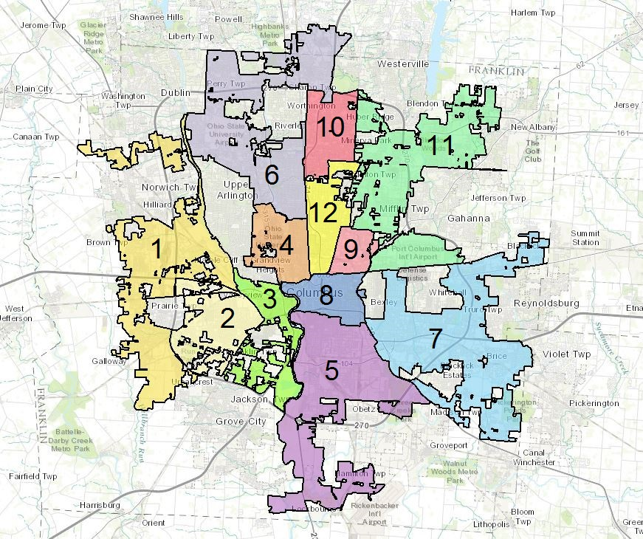

Slide 4
Code Enforcement Process
A Code Enforcement Officer (CEO) issues a notice of violation upon finding a code violation. The notice allows reasonable time for compliance.
The CEO attempts to contact anyone who receives a notice to work with them to resolve the violation.
The citizens that receive notices have the right to appeal notice before the Property Maintenance Board or the Board of Zoning Adjustments.
Approximately 85% of the cases are complied, however, if the violation is not resolved the CEO may recommend a legal action be heard before the Environmental Division of the Franklin County Municipal Court.

Slide 5
Common Code Violations
Housing
The following is a listing of the most common housing violations found during a code enforcement inspection of the interior of a property:
  Plumbing, electric, HVAC, structural finish work
  Unsanitary conditions
  Overcrowded conditions
  Dwelling units unfit for human habitation
  Unsafe buildings
  Smoke detectors: not operable or installed on each floor
  Carbon Monoxide inspections
  Pest infestation

Slide 6
Code Enforcement
Landlord Responsibility
It is the landlord’s responsibility to keep the premises, both interior and exterior at minimum code standards. Examples include the following:
Keep the plumbing and water-heating facilities in good and working condition.
Maintain all electrical power lines, outlets, fixtures, and proper fusing for the premises.
Maintain heating facilities in good and working condition.
Landlord shall not knowingly rent any unit for occupancy which does not meet minimum code standards.
Provide contact information, in writing, to the tenant. Must include name, address, and business or residence telephone numbers.

Slide 7
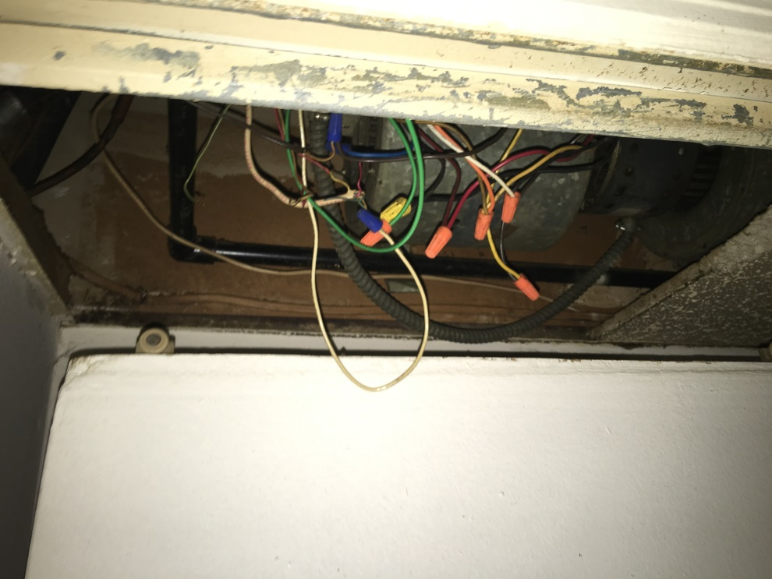
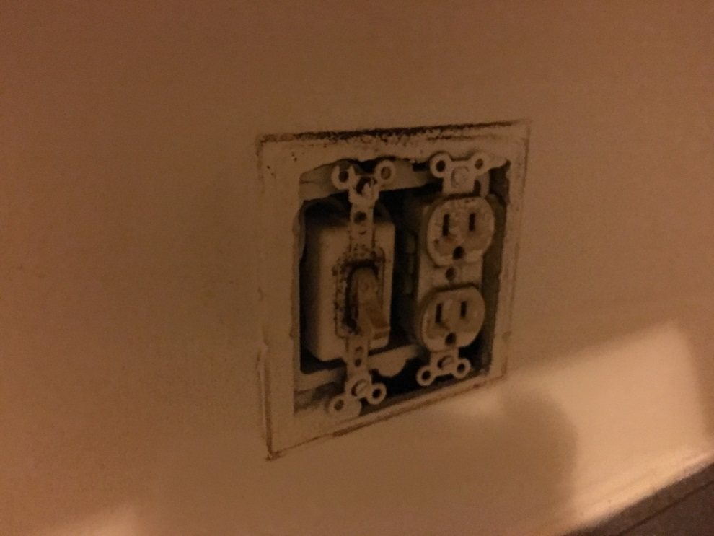
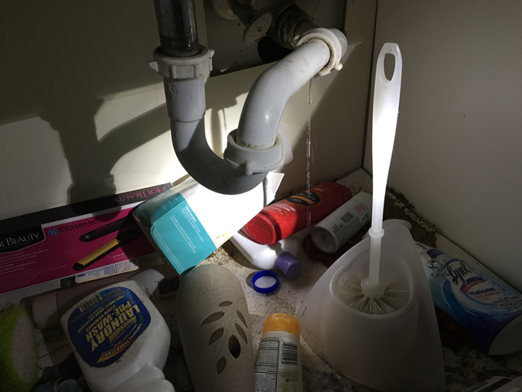
Landlord Responsibility- Exposed wiring, missing covers, water leaks.
Water Leak!

Slide 8
Code Enforcement
Landlord Responsibility
Provide smoke detectors for each level of the dwelling.
  Note- Tenants are responsible for the maintenance and/or replacement of batteries.
Provide windows and doors leading to the outside with functioning locking devices.
  Note- Not all windows must open. At least one openable window to the outside in each habitable room.
Structure must be watertight, rodent proof, and weathertight.
Handrails must be in place that lead between interior floors.
Fencing must be maintained in good condition.
There should be no holes in the walls, ceilings, or flooring.

Slide 9
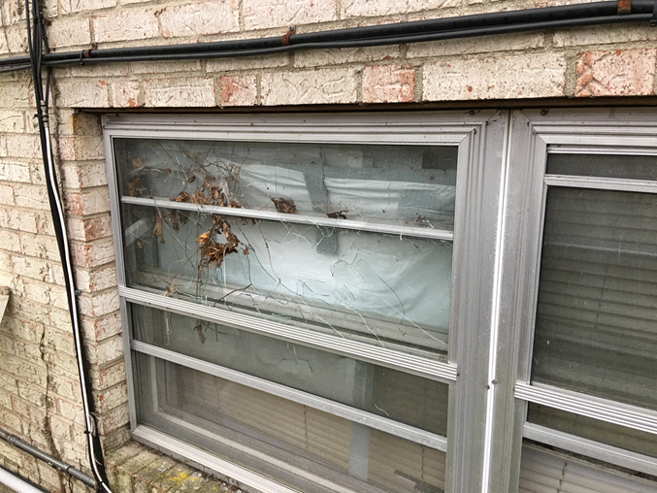
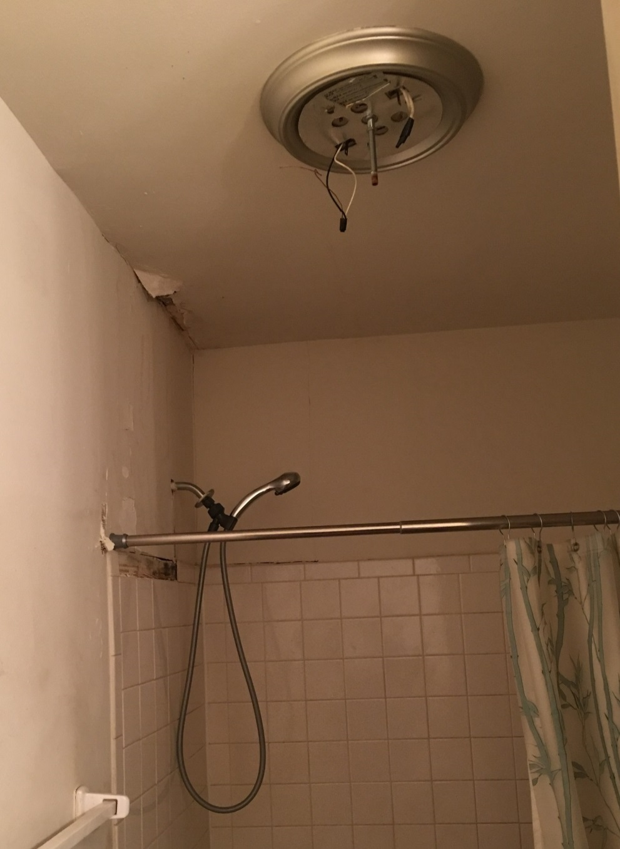
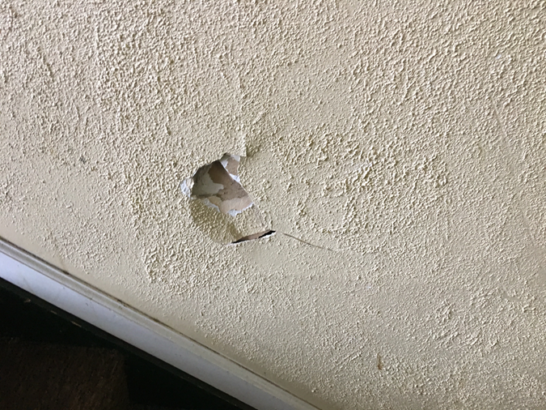
Landlord Responsibility- Broken windows, holes, missing light covers

Slide 10
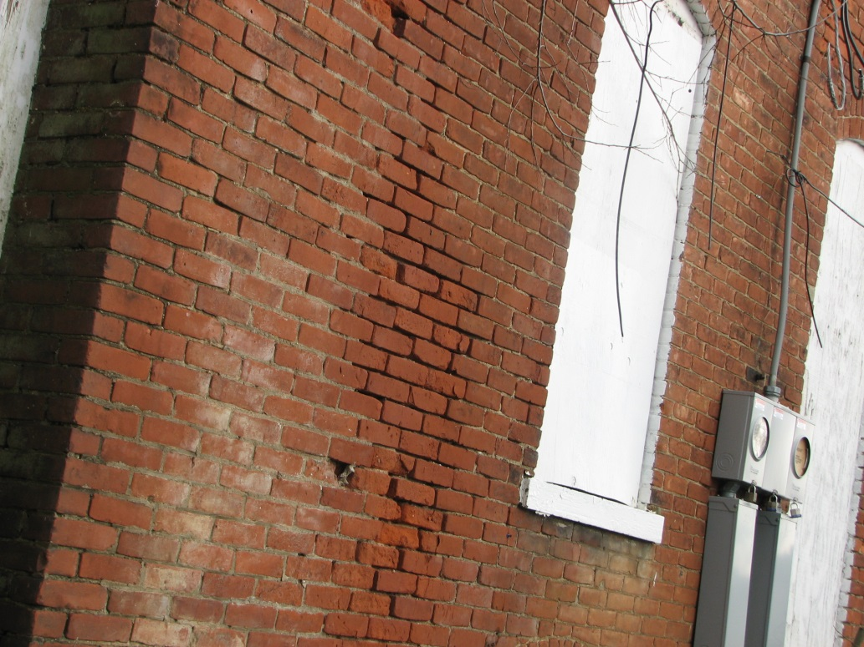
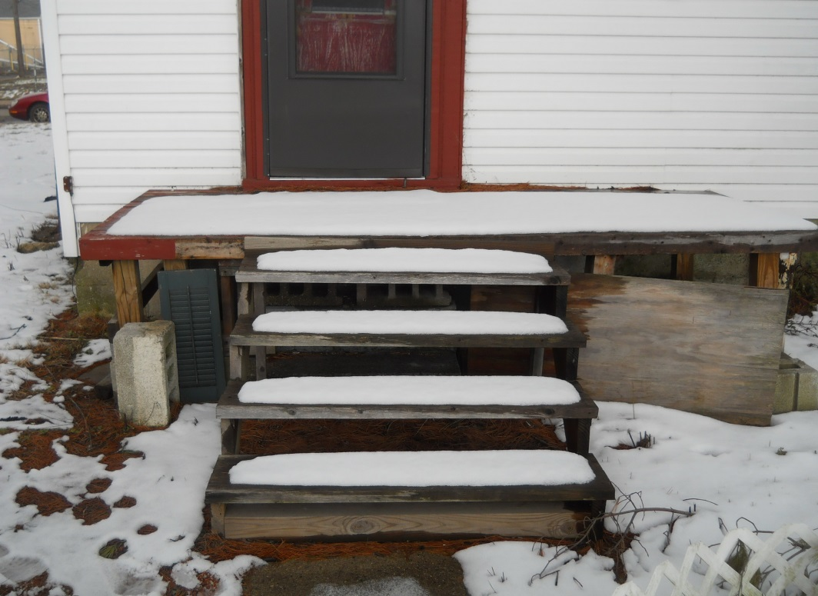
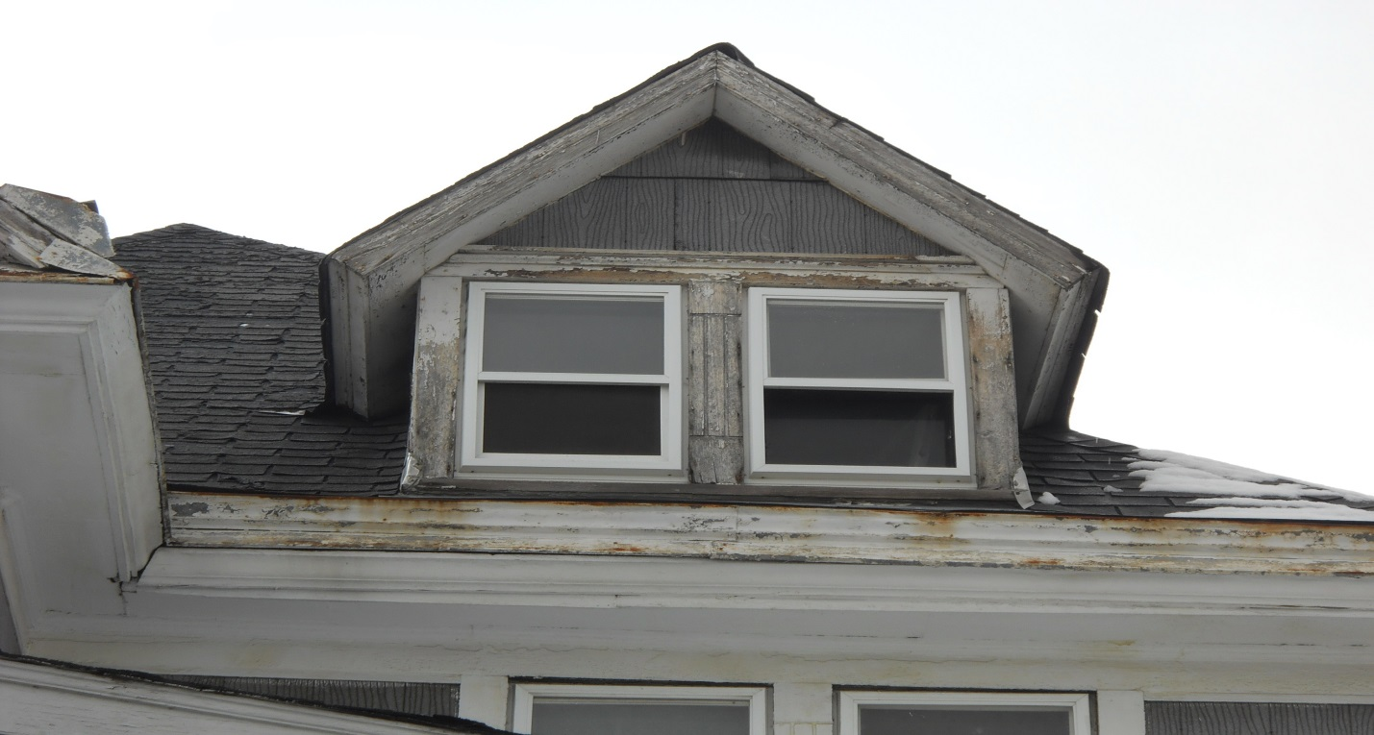
Brick deteriorating and has mortar voids.
Step handrail missing.
Exposed wood around windows and fascia.

Slide 11
Code Enforcement
Landlord/Tenant Responsibility
Infestation(s)
The owner is responsible for elimination of any insects, rats, or other pests in a dwelling containing two (2) or more dwelling units and on the premises thereof. He is also responsible whenever the infestation is caused by improper rat proofing of the premises.
The occupant is responsible for elimination of any insects, rats, or other pests within that part of the premises occupied and controlled by him in a single family dwelling or in a dwelling containing two (2) or more dwelling units if his unit is the only one infested unless infestation of the premises was caused by the improper rat-proofing.

Slide 12
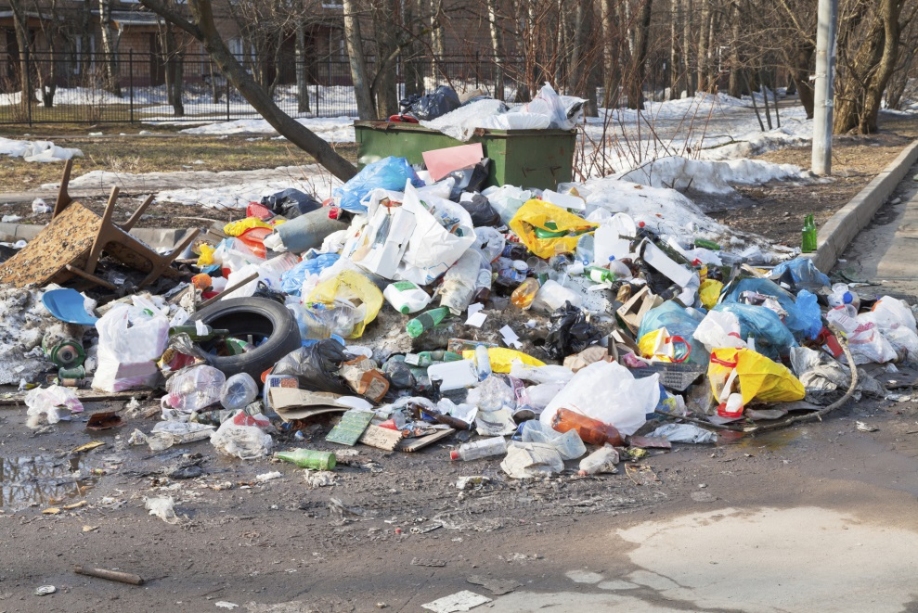
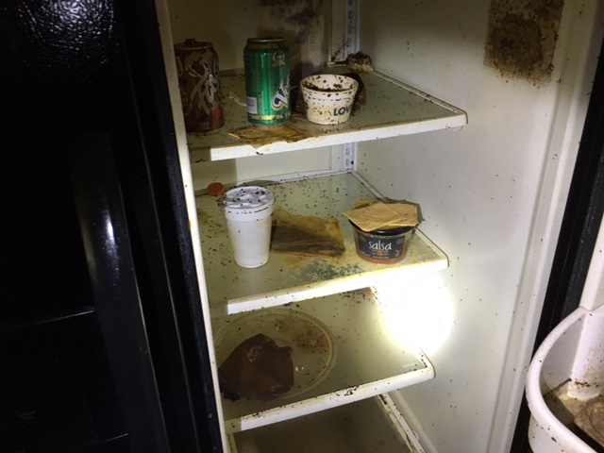
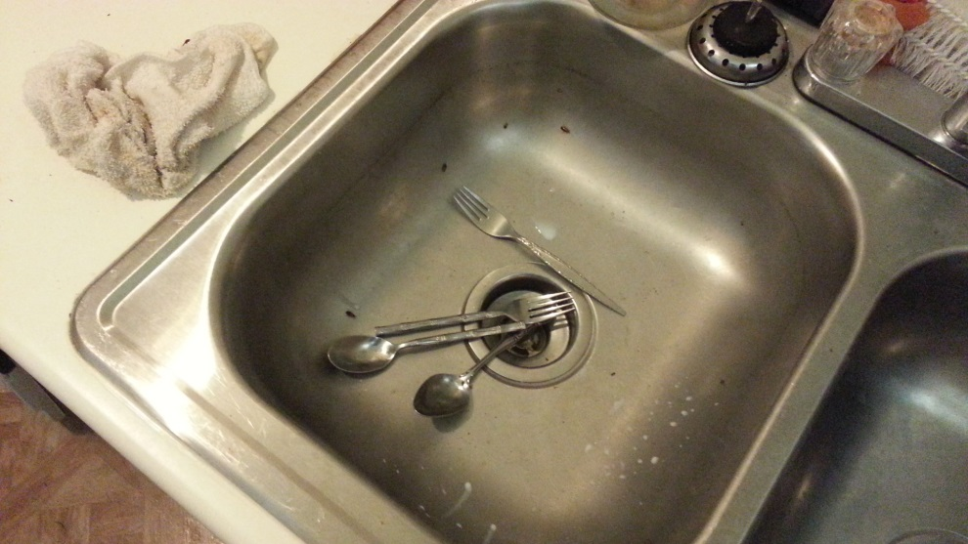
Landlord/Tenant Responsibility- Unsanitary conditions, infestations

Slide 13
Code Enforcement
Tenant Responsibility
Sanitary Maintenance
It is the tenant’s responsibility to keep the premises, both interior and exterior, clean. Examples include the following:
Keep the floors and walking surfaces free of dirt, garbage, waste, litter, and refuse.
Clean the walls, ceilings, windows, and doorways free from dirt, greasy film, soot, and unsanitary matter.
Dispose of all trash, rubbish, and garbage in appropriate receptacles.
Cutting the grass, weeds, and rank growth around the exterior of the premises. This includes any rank growth, trash, or debris that may be encroaching into the alley or right-of-way.

Slide 14
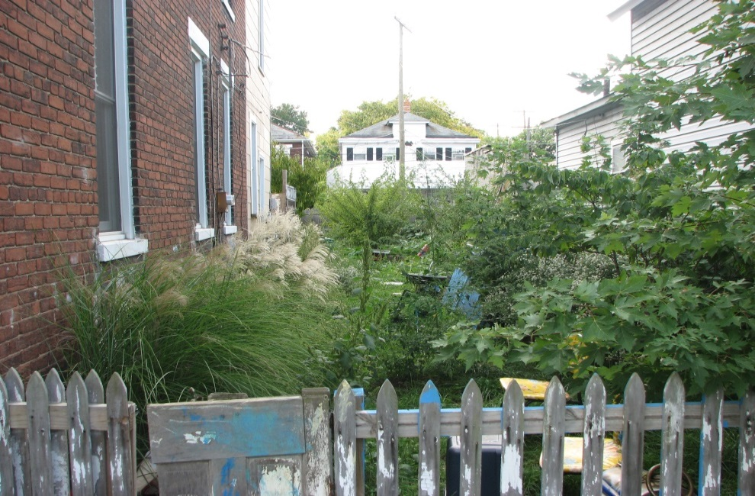
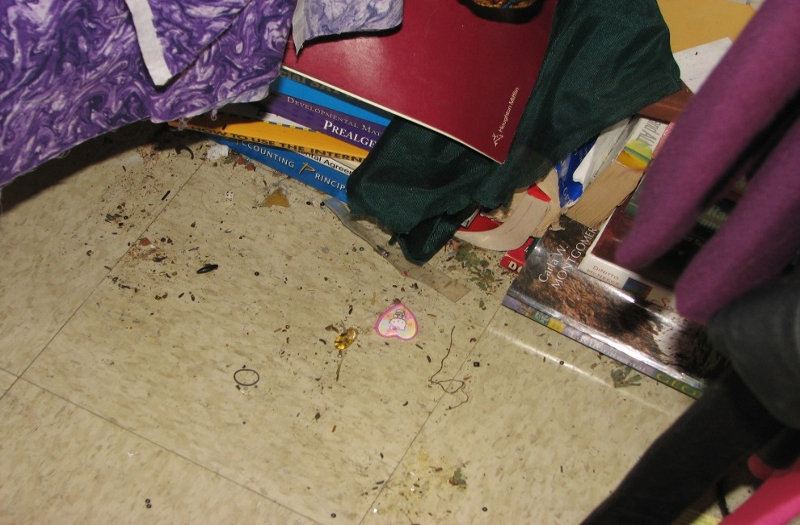
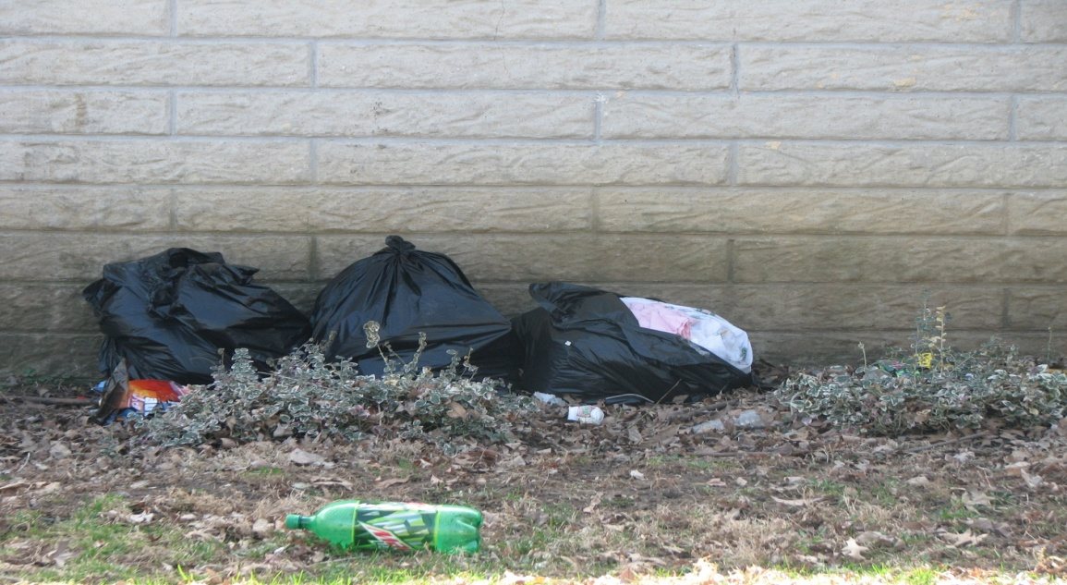
Tenant Responsibility- High grass, weeds, and trash

Slide 15
Code Enforcement
Tenant Responsibility
Interior Obligations
Keep all plumbing fixtures such as toilets, basins, and sinks in a clean and sanitary condition. To avoid the deposit of any material which may obstruct or interfere with the proper function of said fixture.
To properly use all electrical lines, outlets, fixtures, and facilities. Including the proper use of extension cords.
To regulate the heating facilities to maintain above freezing temps at all times in all portions of the dwelling.
To properly store of flammable liquids and materials.
Not allow over-occupancy.
To maintain all smoke detectors in functioning or working condition at all times.

Slide 16
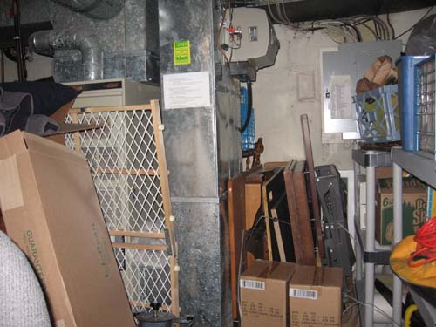
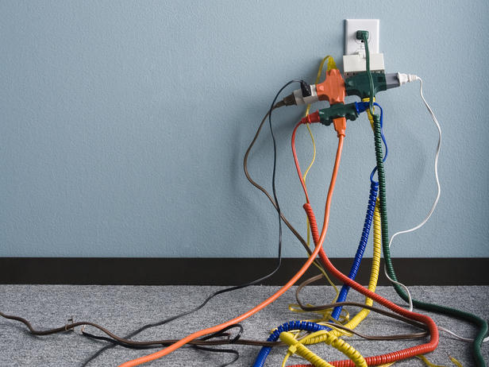
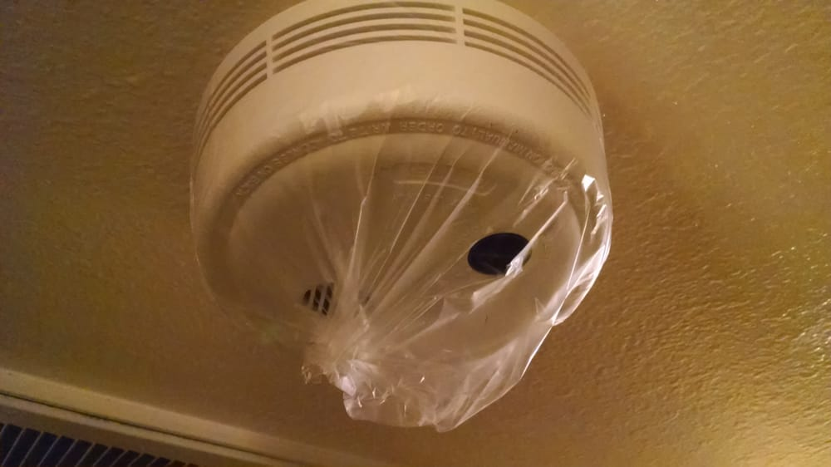
Tenant Obligations- Improper storage, smoke detector operation, extension cords

Slide 17
Code Enforcement
Tenant Responsibility
Exterior Zoning
Examples include the following:
To properly park all allowable vehicles in appropriate parking places. It is prohibited to park/store commercial vehicles on premises or park vehicles on unapproved surfaces.
To keep all allowable vehicles in operable conditions. Examples of inoperable conditions: expired or missing tags, more than one flat tire, broken or missing windows, shattered windshield, or missing parts.
To properly store allowable exterior items. It is prohobited to store the following items: boats, airplane, trailer, tires, equipment used in construction trade, household appliances, upholstered furniture, and junk or salvage.

Slide 18
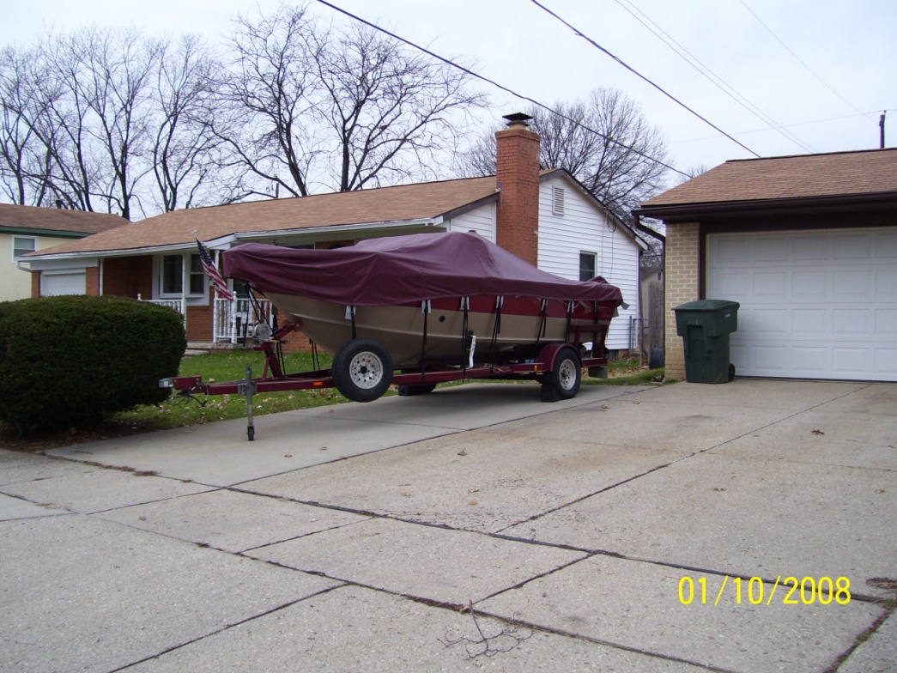
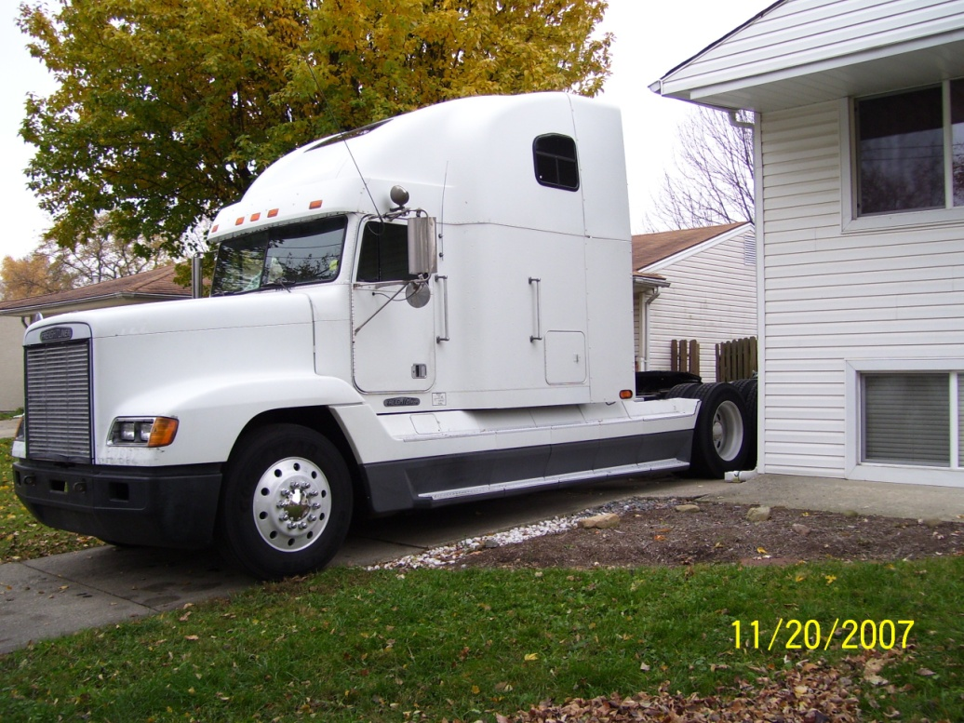
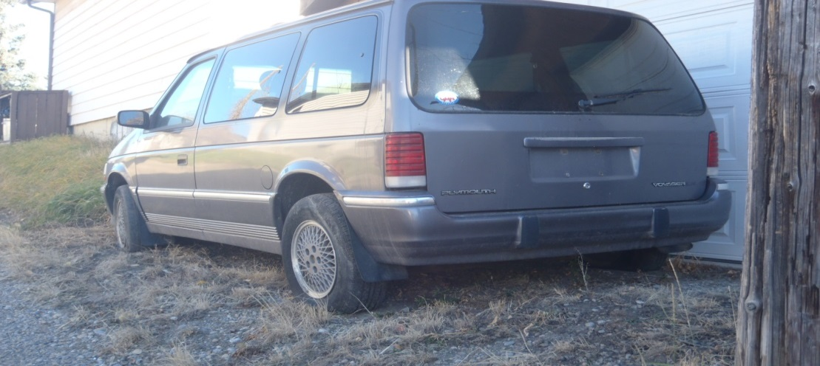
Tenant Responsibility- Storage of boats, commercial vehicles, and inoperable vehicles

Slide 19
Summary-Tenants
It may seem that the owner or landlord has the majority of the responsibilities of their rental properties; the tenant is not entirely excused. The tenant or occupant has a responsibility to keep the property in a sanitary and good condition. Columbus Code section 4551.02 outlines some of the basic responsibilities that tenants have to meet these standards.
https://library.municode.com/oh/columbus/codes/code_of_ordinances

Slide 20
Summary-Landlords
The owner or landlord are responsible for their rental properties. They are legally required to keep their properties in habitable conditions. These items include all electrical, plumbing, heating, ventilating, and supplied appliances in good and operating condition. Columbus Code section 4551.01 outlines some of the basic responsibilities that owners or landlords have to meet these standards.
https://library.municode.com/oh/columbus/codes/code_of_ordinances

Slide 21
Closing
Tenants or Occupants should always call the property management company or landlord when they have issues with their units.
Tenants or Occupants should allow a reasonable amount of time for the responsible party to address the issues.
If the issues are being ignored or not addressed appropriately, the tenant should consider calling the appropriate department for assistance:
  Code Enforcement.
  Health Department.
  Police Department.
  Legal Aid.
Complaints should be initially called in to the “311” office (614-645-3111). This ensures that each complaint will be properly registered and tracked for future updates.

