Slide 1


2022 Program Review & Certification
Monitoring Guide for Subrecipients – updates approved January 2022
While some review items have to be completed on-site, there are many monitoring items that can be completed remotely. References to site reviews in the monitoring guide were updated to say review. Monitoring guide and standard references to CSP were updated to HMIS.
Data Treatment Guidance
  The HMIS User Agreements are now stored and updated in HMIS, so this requirement was removed. HMIS provides automatic compliance for user agreements.
  HMIS bed list was changed to HMIS Program Roster.
  The review timeframe example was updated. A change in the annual review month may extend the timeframe.
Finance, Personnel, Governance includes enhanced risk monitoring issues and timeliness as part of the determination.
Service Provision clarifies that technical assistance may not be CSB-led.
Exhibit 1 data elements chart was updated by program type.
Notes:
This is an overview of updates made to the 2022 Program Review & Certification documents and process. There are very few substantive changes, and most adjustments are simplifications and clarifications. Some of these changes are in response to partner agency questions, the HMIS transition, feedback during last year’s PR&C process, and some reflect regulatory requirements.

Slide 2
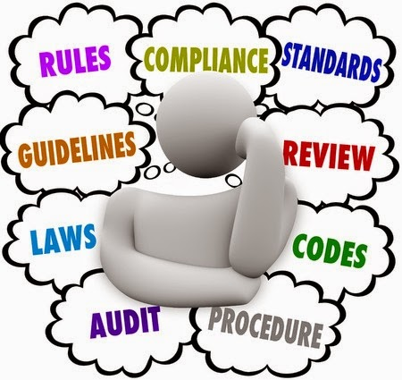
2022 PR&C Standards Updates
A
Organizational Structure, Management, & Personnel
Updated A7, A13
Updates made regarding disaster recovery and crisis communication monitoring method and system meetings types
In partnership with CSB’s financial and compliance consultant, there are changes to the fiscal standards. Although the changes are clarifying and not substantive, we encourage partners to review these standards in detail. An updated internal
control questionnaire and accounting/financial
policies and procedures will be reviewed in 2022. Changes
are clearly noted in green or red font.
D
Fiscal Administration
Notes:
The following slides list the standards with updates this year. Standard changes are in in green font (monitored this year) or red front (reviewed, but not monitored) and easily identified.

Slide 3
2022 PR&C Standards Updates
E
Program Operations
Updated E2, E3, E4, E5, E7, E11, E12, E13, E14
Guidelines for shelter includes no maximum length of stay and service restrictions entered in HMIS public alerts
Updated homelessness documentation HMIS screens, noted website reference material, and added CARR Team documentation
Clarified PSH USHS and annual review documentation
Updated eligibility monitoring method and TSP language and removed RRH timeframe
Standard E14 was changed from tier 3 to tier 2 and will be monitored in 2023
Added guidelines for termination and appeals
Removed RRH and Prevention case review and closure checklist
F
Clients Rights
Updated F3, F4, F9, F11

Slide 4
2022 PR&C Standards Updates
G
Services Planning
Updated G2, G4
Replaced Prevention and RRH checklist with monthly assessment guidelines
Updated case note, prioritization, and screening HMIS documentation
Removed Safety and Outreach program types from standard G4 and added CARR Team guidelines
Included guidelines for RRH rent sustainability, annual income assessment and rent contribution, and updated FMR requirements
Added shelter habitability inspections
Updated master lease lead-based paint guidelines
H
Housing
Updated H4, H5, H7, H9
J
Facilities
Updated J2, J4, J6, J7, J8, J9, J11, J12, J17, J18

Slide 5
2022 PR&C Standards Updates
K
Direct Client Assistance
Updated K1, K2, K3
Updated training and resources guideline
Added DCA payee guidance
Clarified client acknowledgement form documentation and remote intake notices
Updated HMIS language and user agreement auto compliance
Separated exit and entry date accuracy and data accuracy standards
M
Data Collection
Updated M3, M4, M5, M7, M9, M13

Slide 6

2022 COVID-19 References
COVID-19-provider-guidance
Waivers
  COVID19-waiver-checklist-updated-2/7/22
Standards impacted by COVID-19 waivers will be monitored based on the timeframe in the CSB communication
  RRH-HP-PSH-COVID19-Guidance 12/30/21.pdf
Ask questions - we want the visit to be as easy as possible and want to
help with any aspect of compliance prior to, during, and after the PR&C.

Slide 7
2022 PR&C Documentation Resources
Housing Materials
  Direct Client Assistance Resources
  Fair Market Rent and Rent Reasonableness calculator
  Utility Allowances
  Habitability and housing quality standards inspection forms
  Lead-based paint resources
  VAWA Resources
Homeless Crisis Response System Policies and Procedures
  Annual PSH Provider Assessment of Services Needs and Utilization
Shelter Materials
  Housing Assistance Screening Tool (HAST)
  Individualized Housing Stabilization Plan (IHSP)
CSB monitoring materials
HEARTH Act
CoC Interim Rule (24 CFR Part 578) and the ESG Interim Rule (24 CFR Part 576)

