Slide 1




Slide 2

What is NSPIRE?
The National Standards for the Physical Inspection of Real Estate is the new physical inspection model to inspect all HUD-assisted housing beginning 10/01/2025.
It was developed by HUD’s Real Estate Assessment Center (REAC). This is a department of HUD that evaluated the physical condition of properties HUD has a financial interest or obligation to monitor.
It is designed to align multiple HUD programs to a single set of inspection standards which will effectively replace the Physical Condition Standards (UPCS), and Housing Quality Standards (HQS).

Slide 3

Goals of NSPIRE
Prioritize health and safety of residents
Less focus on appearance
Increased emphasis on the unit and functionality
Modernize HUD’s inspection process
Decrease administrative burdens on Public Housing Authorities.
Improve service delivery times
“To ensure that all residents live in safe, habitable dwellings.”
-NSPIRE Mission Statement

Slide 4

Let’s take a pretest
Let’s complete the pretest together as a group.

Slide 5

HUD Training Videos
We will be utilizing the videos from the HUD Exchange Learn NSPIRE Inspector Training Program. This will enable you to go back and watch them as needed in the future for re-learning needs.
Inspections Overview
Inspecting Outside
Inspecting Inside
Inspecting the Unit
Ending an Inspection

Slide 6

NSPIRE Checklist and Resources
NSPIRE HCV/PBV Inspection Checklist
NSPIRE CTQ Unit Health and Safety
NSPIRE Workbook-this is an important tool as we are not able to go through every possible inspection scenario during this course
https://www.hudexchange.info/trainings/nspire-inspector-training/ you will need to set up your own account

Slide 7
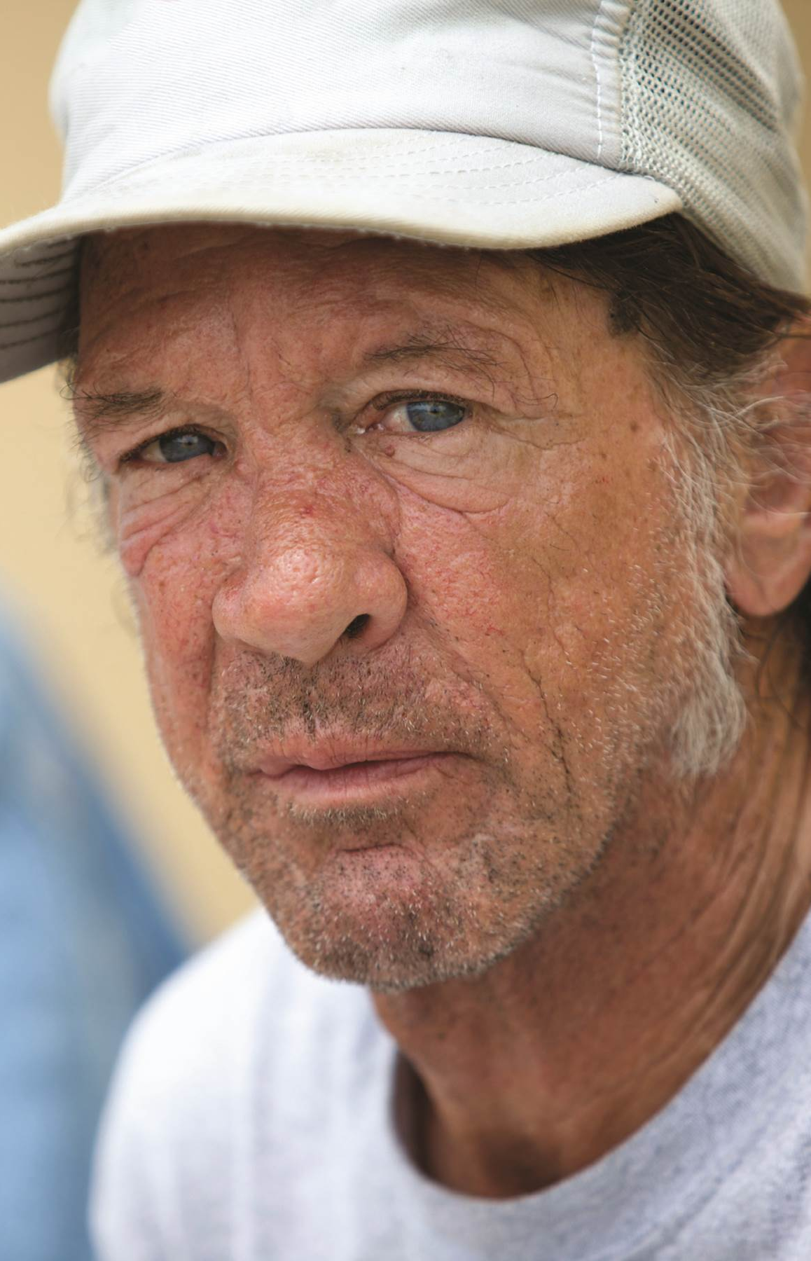
Let’s take a posttest
Let’s complete the posttest together as a group.

Slide 8

QUESTIONS?
Derek Fry, Housing Inspector
dfry@csb.org
Jennifer Birmele, Housing Director
jbirmele@csb.org

