Slide 1
FY 2026 Continuum of Care Competition and Youth Homelessness Demonstration Program Grants NOFO
Local Application Funding Notice - Application Orientation
Renewal, New + Transition Projects
July 8, 2026, 11:30 a.m. to 12:30 p.m.
Notes:
Presenter: Sara
Time: 3 minutes (start at 11:33 am)

Slide 2
Agenda & Purpose
Housekeeping
CoC Competition General Information
FY2026 NOFO Priorities
Project Types
Local Information
Local Application
Renewal Project Specifics
New + Transition Project Specifics
Application Submission
Scoring
Q&A
Notes:
Presenter: Sara
Time: 1 min (11:34am)

Slide 3

HOUSEKEEPING
Workshop Purpose and Focus​- This workshop orients applicants to the FY26 CoC Program and local application processes to ensure understanding of federal and local requirements
CSB Staff Introductions
Provide your name and organization in the chat
Questions
  can be submitted throughout the workshop via the chat
  will have time at the end to go through questions
  All questions will be answered on the Q&A document on the CoC website About » Community Shelter Board
Notes:
Presenter: Sara
Time: 3 min (11:37 am)

Slide 4
OVERVIEW – CONTINUUM OF CARE NOFO COMPETITION
CoC NOFO application is the process by which over 400 Continuums across the country apply to HUD for CoC funding.
HUD awards funding based on available funding, individual project alignment with HUD priorities, and CoC overall application score.
Community Shelter Board is the Unified Funding Agency and Collaborative Applicant for the Columbus and Franklin County CoC.
Notes:
Presenter: DaiJhah
Time: 1 min (11:38 am)

Slide 5
COC NOFO APPLICATION PROCESS
National Competition
Allocates HUD funding based on application performance and alignment with priorities.​
Each CoC submits its application, including priority listing, to HUD.
Scores on both the CoC application and individual project applications impact the amount of funding that each CoC receives, and ultimately, which projects are funded.
Notes:
Presenter: Daijhah
Time: 1 min (11:40 am)

Slide 6
COC NOFO APPLICATION PROCESS
Local Application Process
CSB solicits local applications.
CoC Board and Membership approve scoring criteria and rating, ranking and selection policies.
Review Committee ranks applications based on prioritization.
COC approves Collaborative Application, including the Priority Listing, which is submitted to HUD by CSB.
Notes:
Presenter: DaiJhah
Time: 1 min (11:39 am)

Slide 7
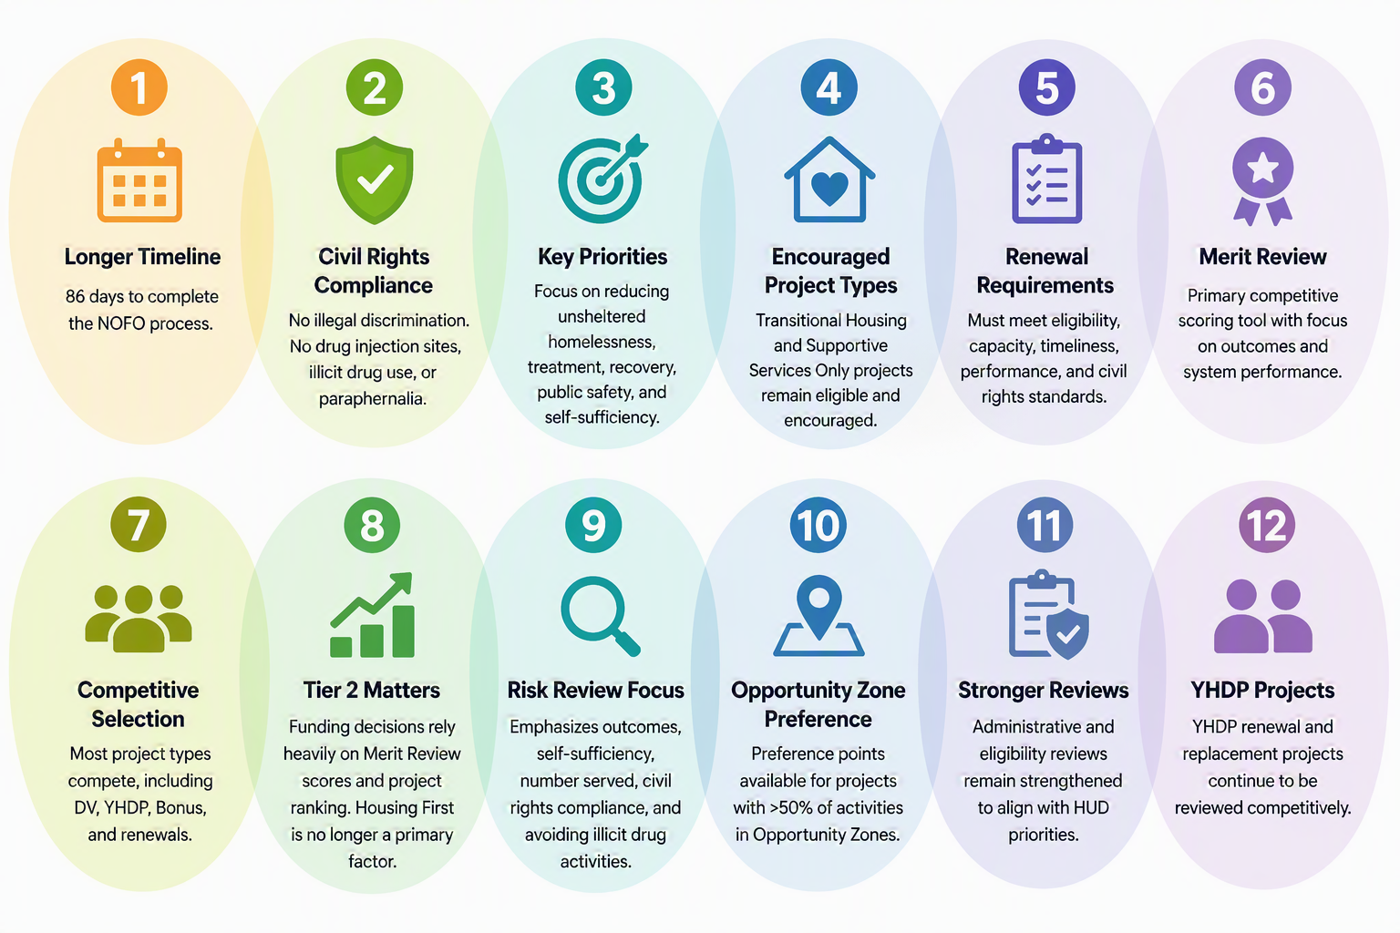
HUD FY2026 NOFO POLICY PRIORITIES
Notes:
Presenter: Samba
Time: 5 min (11:45 am)

Slide 8
PROJECT TYPES
Notes:
Presenter: Samba

Slide 9
TRANSITIONAL HOUSING
Provides up to 24 months of temporary housing with supportive services to people experiencing homelessness.
  Goal is for clients to exit to independent living without government assistance.
Designed to provide interim stability and support to successfully move to and maintain permanent housing.
May be Site-Based or Scattered-Site.
Participants expected to engage in 20 hours per week of services and/or employment.
HUD will not accept new Joint TH/PH-RRH component project applications.

Slide 10
SUPPORTIVE SERVICES ONLY (STANDALONE)
Provides supportive services to people experiencing homelessness for whom the agency is not providing housing or housing assistance.
  Goal is to connect households experiencing homelessness to housing and community resources.
May provide services to sheltered or unsheltered individuals and families, depending on the project design.
Services may include assessment, housing navigation, case management, referrals, housing search and placement, and housing stabilization.
Standalone SSO projects are limited to eligible CoC Program activities, such as Coordinated Entry or other HUD-approved supportive service activities.

Slide 11
SSO: STREET OUTREACH
Provides supportive services to people experiencing unsheltered homelessness by connecting them to emergency shelter, housing, or critical services, and urgent, non-facility-based care.
  Goal is to connect individuals and families to emergency shelter, permanent housing, health care, and other critical community resources.
Services may include street-based case management, assessment, housing navigation, referrals, transportation, emergency supplies, and connections to mainstream benefits and health services.

Slide 12
PERMANENT SUPPORTIVE HOUSING(PSH)
Provides permanent housing with long-term rental assistance and supportive services for people with disabilities experiencing homelessness.
  Goal is to help participants obtain and maintain permanent housing while maximizing independence.
Designed to serve persons with disabilities who need ongoing housing stability and supportive services.
May be Site-Based, Project-Based, Sponsor-Based, or Tenant-Based, as permitted by the project design.
Supportive services must be available to assist participants in maintaining housing.

Slide 13
PERMANENT HOUSING –
RAPID RE-HOUSING (PH-RRH)
Provides short- to medium-term rental assistance and supportive services to quickly move people experiencing homelessness into permanent housing.
  Goal is to rapidly exit homelessness and achieve housing stability.
Supportive services may continue after housing placement as needed.

Slide 14
NOFO TIMELINE
Activity ​ | Timeline ​
CoC, Partner Agency, and Public Updates ​ | Weekly ​
Current Partner Agencies Intent to Apply ​ | 06/22/2026- Released ​ 6/25/2026- Deadline ​
CoC Prioritization Approval ​ | 06/25/2026 ​
Renewal and New/Transition Project Applications Released (Word Document) ​ | 07/02/2026 ​
Weekly NOFO Technical Assistance Office Hours ​ ​ | 07/02/2026 - 08/13/2026 ​ Thursdays 9:30-10:30AM ​
Application Deadline (5:00 PM) ​ | 07/22/2026 ​
CoC Board Application Score Review and Recommendations ​ | 08/06/2026 ​
CoC Membership Application Review and Approvals ​ | 08/11/2026 ​
Notification on Project Applications ​ | 08/12/2026 ​
Desired Consolidated Application Submission to HUD ​ | 08/24/2026 ​
CoC Consolidated Application Due to HUD ​ | 08/26/2026 ​
Notes:
Presenter: Samba
Time: 1 min (11:46 am)

Slide 15
TIER 1 PRIORITIZATION
1. Renewal HMIS projects.
2. Renewal Coordinated Entry (SSO) projects.
3. Renewal Transitional Housing projects serving Transition Age Youth.
4. Renewal Permanent Supportive Housing (PSH) projects that are currently operational and serving clients with adequate operations funding.
    Fixed-Site Renewal PSH . . . up to Tier 1 amount or closest amount.
    Renewal Family-Dedicated PSH (at least 50% of units dedicated to families).
    Renewal PSH-rental assistance.
5. New PSH projects that are currently operational and serving clients but do not receive CoC funding yet and have a documented funding gap.
  Fixed-Site PSH using the scoring and rating criteria described below, in descending order of their score based on the total accumulated points, in an amount not to exceed $1,500,000.00.
Notes:
Presenter: Samba (3 slides)
Time: 5 min (11:51 am)

Slide 16
TIER 2 PRIORITIZATION
1. New RRH, TH, SSO or SSO-CE following the new project development process, using the DV Bonus funds available.
2. New SSO and TH through reallocation or transition of PSH-leasing, PSH-rental assistance, RRH, RRH, and TH-RRH as ranked by the CoC and following the new project development process.
3. New SSO, SSO-CE and TH following the new project development process, using the CoC Bonus funds available.
4. Renewal Rapid Rehousing.
5. Renewal Joint TH/RRH.
6. Renewal PSH projects that are not presently operational and not serving clients. Renewal PSH projects without committed operational funding support.
7. Any Renewal project that did not follow the locally established competition guidelines will be ranked as the last renewal project in Tier 2.
Notes:
Presenter: Samba (3 slides)
Time: 5 min (12:01 pm)

Slide 17
AVAILABLE FUNDING
Annual Renewal Demand (ARD) | Tier 1 (60% of ARD) | COC Bonus (Estimated) | DV Bonus (Estimated)
$27,047,015 | $16,228,209 | $4,057,052 | $2,581,580
Notes:
Presenter: Samba (3 slides)
Time: 4 min (12:01 pm)

Slide 18
APPLICATIONS
Notes:
Presenter: Samba

Slide 19
Completing the Application
• Understand application structure​.
• Avoid threshold failures​.
• Write strong narratives​.
• Complete attachments.​
• Submit complete package to grants@csb.org by 5:00 PM on Wednesday July 22, 2026.
Notes:
Presenter: Sara
Time: 15 min (11:55 am)

Slide 20
Threshold Requirements
Verify the organization's Unique Entity Identifier (UEI) and active SAM.gov registration.
  A UEI is assigned through SAM.gov and is required to apply for federal funding.
New applicants must provide proof of UEI/SAM.gov registration or application, as applicable.
Provide details for any monitoring findings, if applicable.
Confirm the project meets all Additional Requirements and Project Thresholds.
  All threshold questions must be truthfully answered “Yes” to meet eligibility requirements.
Demonstrate consistency with the Franklin County 2025–2029 Consolidated Plan.
Notes:
Sara, Start by reviewing threshold requirements because applications that fail threshold review cannot advance. Walk participants through UEI, SAM registration, compliance certifications, and monitoring findings. Encourage applicants to verify eligibility and supporting documentation before beginning narrative work.
How do you obtain a UEI?
Go to SAM.gov.
Create or sign in to a Login.gov account.
Select"Get Started" and then"Get a Unique Entity ID."
Enter your organization's:
Legal name
Physical address
Submit the request.
SAM.gov assigns the UEI after validating the organization.

Slide 21
PROJECT INFORMATION
Provide complete and accurate contact information.
Complete all Other Questions related to HUD priorities.
  Include a Supportive Services Agreement (template available on the website), if applicable.
  Include Agreements or Letters of Commitment for collaborations serving children and youth, if applicable.
Verify the project type and ensure it meets all HUD eligibility requirements (discussed later).
Identify whether the project is New, Transition, YHDP, or DV (discussed later).
  Review the Information Session Q&As available on the website.
Ensure all application responses are complete and consistent throughout.
Notes:
DaiJhah

Slide 22
Narrative
Tell a Clear Story in the Narrative​
Clearly describe the population to be served and the services to be provided.
New and Transition Projects must complete all required narrative sections and detailed charts.
Renewal Projects must provide a concise narrative summary.
Demonstrate the need for the project. Describe the expected outcomes. Explain how project success will be measured.
Notes:
DaiJhah-Narrative sections should tell a clear story. Explain the need being addressed, who will be served, how services will be delivered, and what outcomes will be achieved. Encourage applicants to use data and specific examples instead of general statements.

Slide 23

CO-APPLICANTS
A project applicant may include one or more co-applicants to carry out eligible project activities. The project applicant remains legally responsible for the grant and overall project performance.
Co-applicants may carry out specific eligible activities identified in the project application and grant agreement.
  Co-applicants must be eligible recipients under the CoC Program.
  Meet all applicable HUD threshold and eligibility requirements.
The project application must clearly identify each co-applicant and describe its roles and responsibilities.
Notes:
DaiJhah

Slide 24
PROJECT BUDGET
• Complete applicable Excel Budget Template.
  FY26 Project Budget for New SSO-Proj-CFC CoC
  FY26 Project Budget for New TH Proj-CFC CoC
  FY26 Project Budget for non YHDP Joint TH-RRH Renewal-CFC CoC
  FY26 Project Budget for Standard Renewal-CFC CoC
  FY26 Project Budget for YHDP Renewal Project
• All applicable tabs completed.
• Cost Reasonableness and Fiscal Management.
  FY26 HUD NOFO - OMB Guidance
  24 CFR Part 278 - 24 CFR 200.404
• Document match in detail and ensure you can provide the detailed documentation, when requested
• Align budget to design
• Budget questions can be answers in Technical Assistance
• Monitor expenditures
Notes:
Sara

Slide 25
APPLICANT CHECKLIST
☐ Completed Project Application with certification signed by an authorized official – PDF and Word
☐ YHDP PROJECTS ONLY: Completed YHDP Addendum (New and Transition Applications)
☐ DV BONUS PROJECTS ONLY: Completed DV Bonus Project Addendum (New and Transition Applications)
☐ Completed Project Budget form with all applicable tabs completed (including match detail) – Excel document
☐ Other commitment letters/agreements as applicable – PDFs
☐ Supportive Services Agreement, if applicable – PDF
☐ Negotiated Indirect Cost Rate Agreement, if applicable (must also complete Indirect Cost Rate information on Fund Request Summary tab in completed Project Budget form) – PDF
☐ Completed HUD-2880 form – PDF
Notes:
Sara

Slide 26
APPLICANT CHECKLIST
☐ Attach proof of SAM application, if not already registered – PDF
☐ Attach proof of UEI requested, if not already registered – PDF
☐ NEW APPLICANTS ONLY: Copy of most recent agency audit – PDF
☐ NEW APPLICANTS ONLY: If non-profit organization, attach 501(c)(3) determination letter from IRS – PDF
☐Agreement(s) for education supports and services for children aged 0-5, if applicable – PDF
☐Any additional documents supporting the narrative that you would like to provide
Notes:
Sara

Slide 27
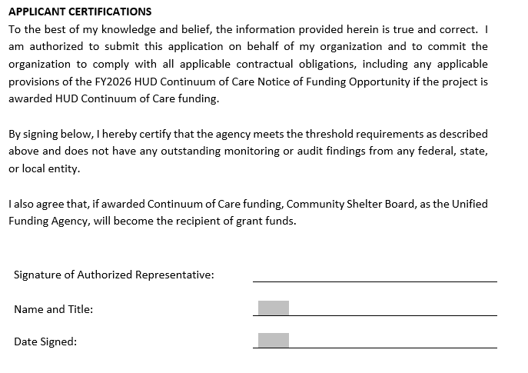
APPLICANT CERTIFICATIONS
Notes:
DaiJhah

Slide 28
RENEWAL PROJECTS
Allowable renewal projects are the projects listed on the Estimated GIW posted on the website.
FY-2025-OH-503-GIW-6.25.26-from-HUD-Updated-for-website-1.pdf
Notes:
DaiJhah

Slide 29

NEW + TRANSITION APPLICATION
New or Transition Project
YHDP project, complete YHDP Addendum
DV project, complete DV Bonus Questions
Additional Requirements
  The CoC Program is intended to increase housing and services for people experiencing homelessness, not simply shift costs from local sources to the federal government. HUD requires recipients and subrecipients to maintain proper documentation showing that grant funds are being used for eligible program costs and that required matching funds are provided. –hud.gov
  Supplanting- using federal CoC funds to replace state, local, or private funds that an organization was already obligated to spend
Notes:
Sara

Slide 30
NEW & TRANSITION APPLICATION
Coordinated Entry detail- Homeless Crisis Response System Policies And Procedures » Community Shelter Board
Transitional Housing and Permanent Supportive Housing Only Questions (bottom of application page 8 – bottom of page 10)
Supportive Services Projects Only (bottom of application page 10 – top of page 12)
Supportive Services- Coordinated Entry Only (top of page 12 – middle of page 12)
Everyone completes Applicant information- Project Budget (page 13)
YHDP Addendum (page 14 – page 17)
DV Bonus Questions (page 18)
Notes:
Sara

Slide 31
SUBMISSION INFORMATION
Complete Application Packages/Emails must be received by July 22, 2026 by 5:00 PM.
Submitted to grants@csb.org
First-time applicants are welcomed
Prior CoC experience is not a requirement
No limit on number of applications that can be submitted; a complete package and separate email submission is required for each application
Notes:
DaiJhah

Slide 32
APPLICATION + BUDGET SCORING
Notes:
Presenter: Samba

Slide 33
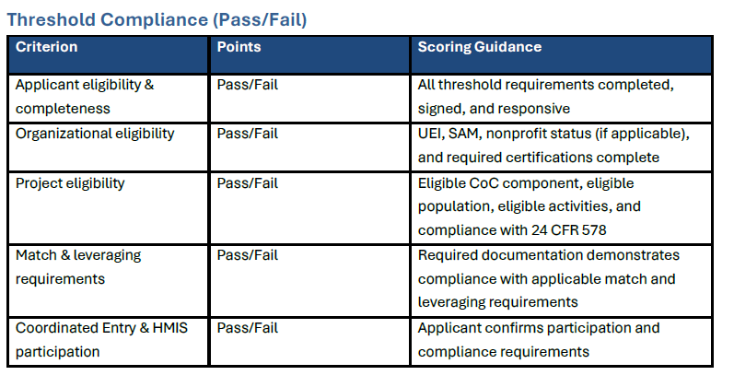
NEW + TRANSITION PROJECT SCORING

Slide 34
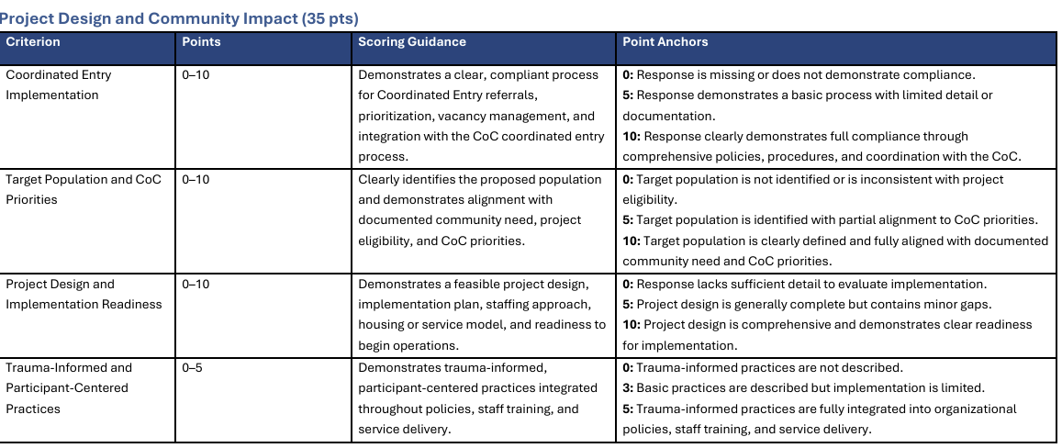
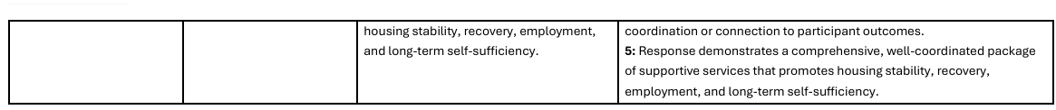
NEW + TRANSITION PROJECT SCORING

Slide 35
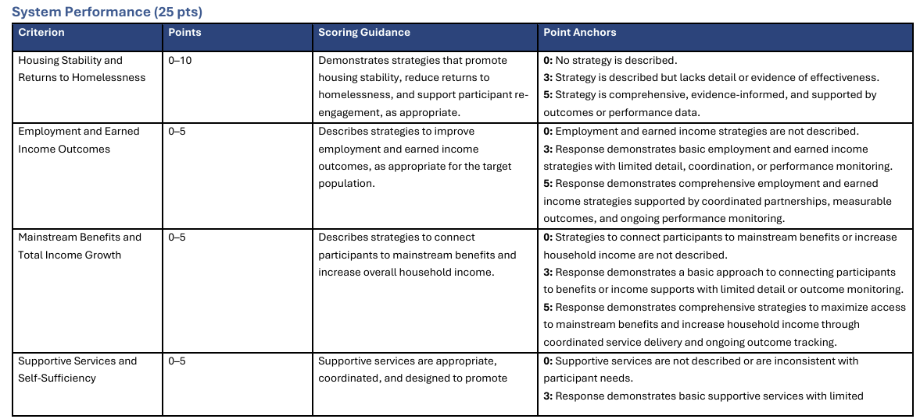
NEW + TRANSITION PROJECT SCORING

Slide 36
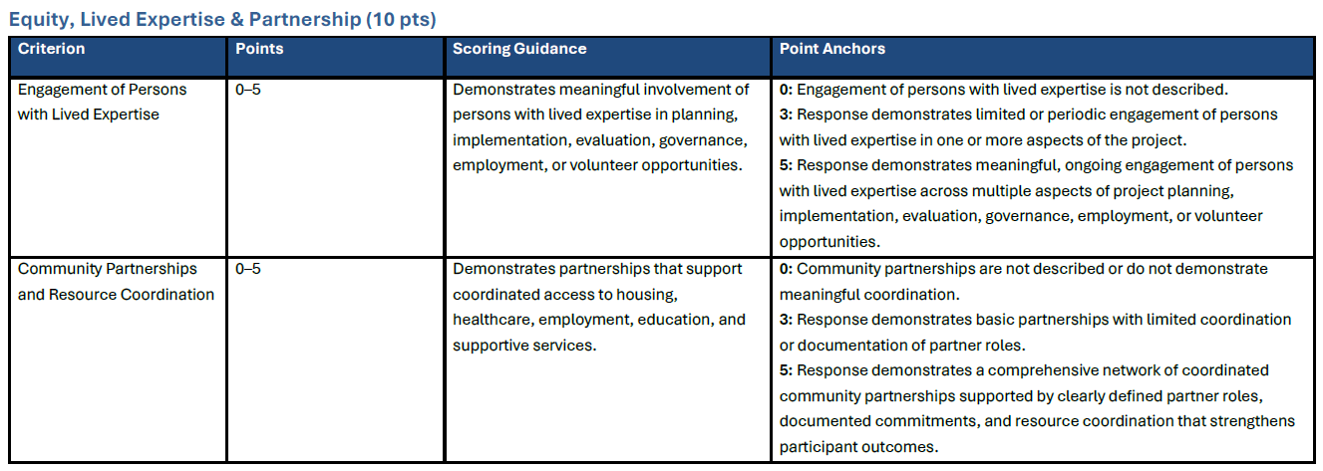
NEW + TRANSITION PROJECT SCORING

Slide 37
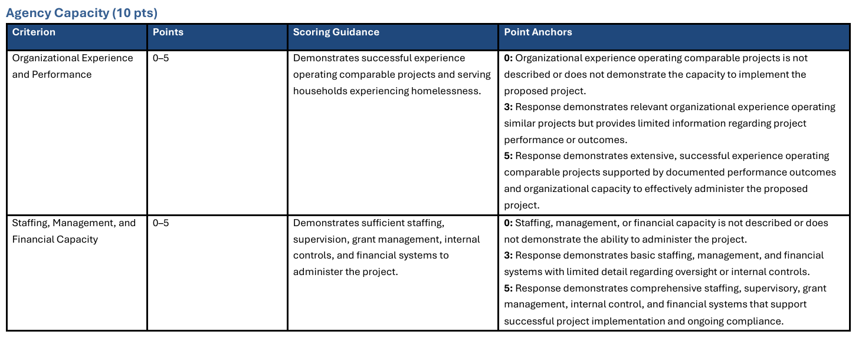
NEW + TRANSITION PROJECT SCORING

Slide 38
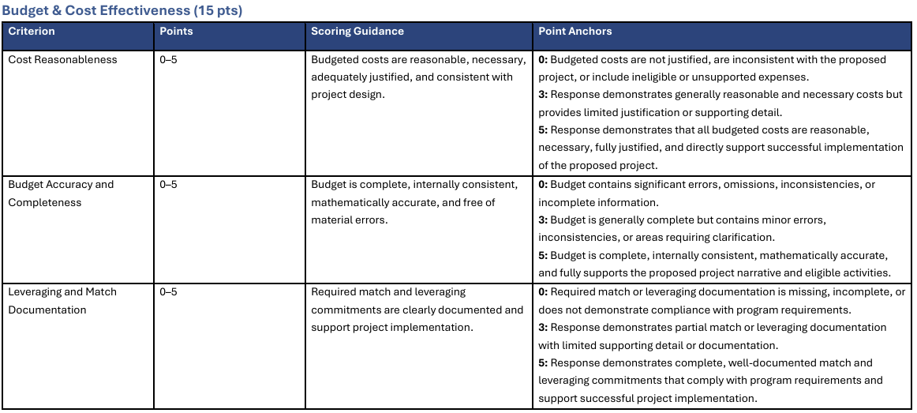
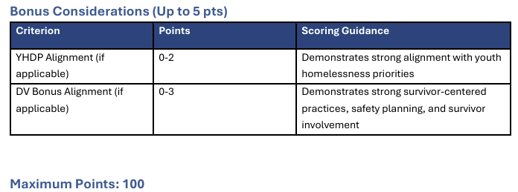
NEW + TRANSITION PROJECT SCORING

Slide 39
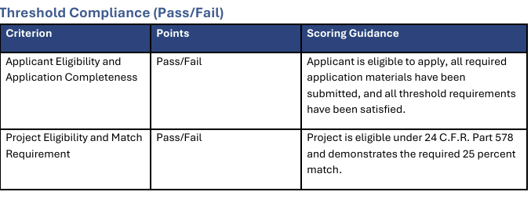
RENEWAL PROJECT SCORING

Slide 40
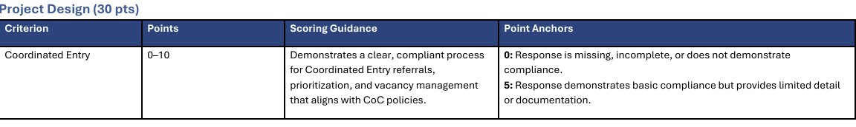
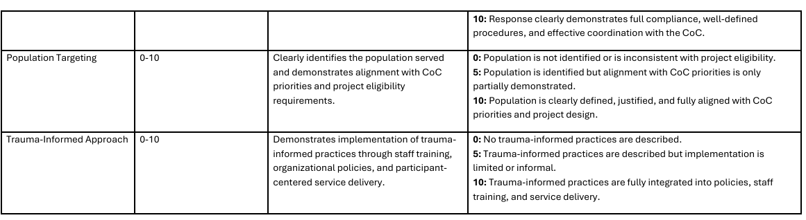
RENEWAL PROJECT SCORING

Slide 41
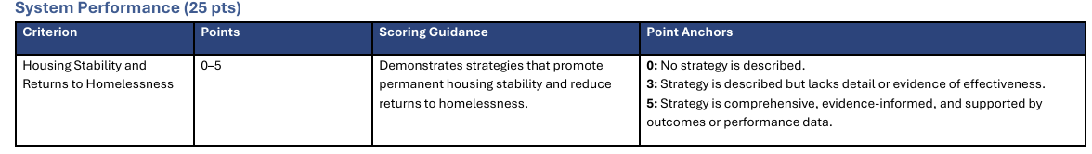
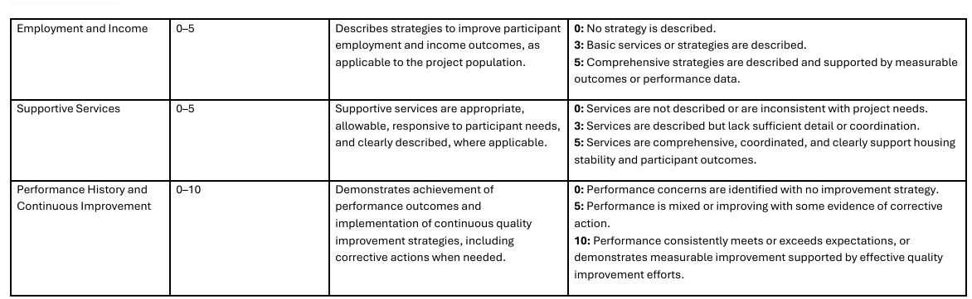
RENEWAL PROJECT SCORING

Slide 42
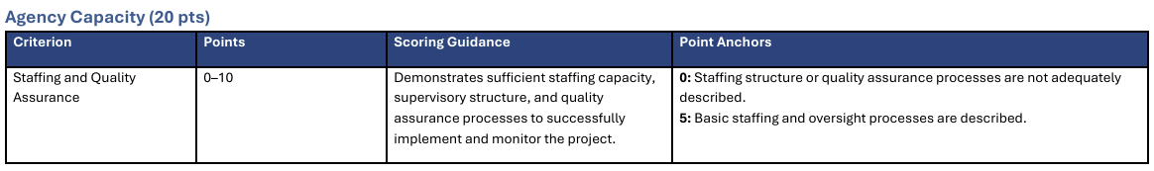
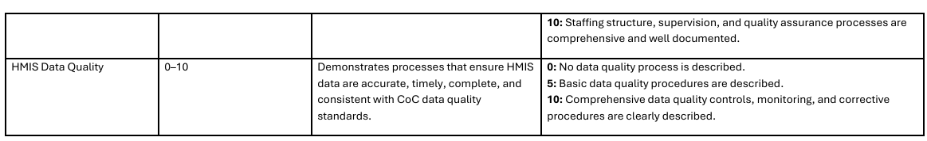
RENEWAL PROJECT SCORING

Slide 43
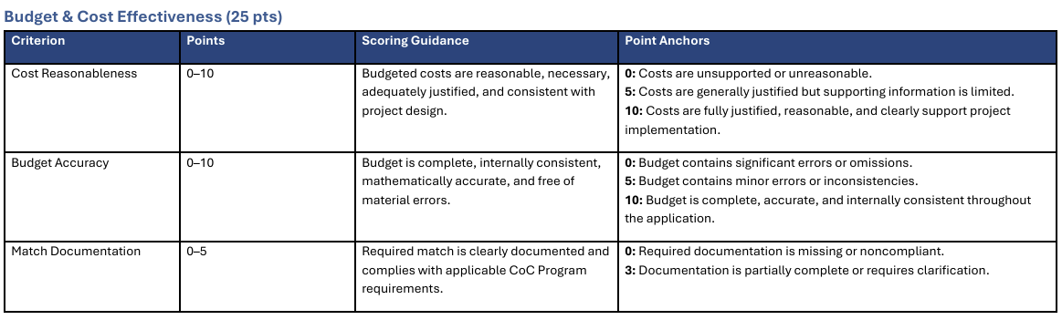
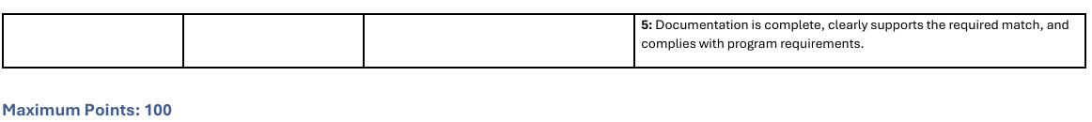
RENEWAL PROJECT SCORING

Slide 44
Thank you

